Slide 1
Windows Azure Web Sites Deep Dive Jump Start
James Chambers | Author, Microsoft ASP.NET/IIS MVP
Tejaswi Redkar | Author, Director of Business Programs (AppPlat)

Slide 2

Meet James Chambers | ‏@CanadianJames
An “In the trenches” Developer on the .Net stack
Over 15 years professional development experience in a mix of languages and environments
Has built applications in a variety of industries, from health care and oil & gas to restaurant and resource management
Author and Speaker
Frequent speaker at conferences, user groups and internal company workshops
Chosen for Microsoft MVP award in Asp.Net/IIS for technical community involvement, mentorship and providing real world solutions
http://jameschambers.com -

Slide 3

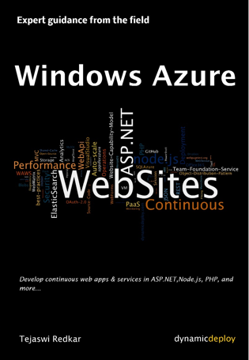
Meet Tejaswi Redkar | @tejaswiredkar
Director of Business Programs, Microsoft
Solutions Architect focused on everything cloud
Dirty hands from 100+ solutions on Windows Azure
Worked on Windows Azure since its inception
Author, Developer, Community Lead
Author of several books – latest Windows Azure Web Sites
http://www.amazon.com/Windows-Azure-Web-Sites-Building/dp/1491003545/
Creator of Dynamic Deploy – http://www.dynamicdeploy.com
http://blog.dynamicdeploy.com on Windows Azure App Deployments
Creator of StorageCopy http://www.dynamicdeploy.com/storcopy.aspx

Slide 4

Meet Demo Demon
Director of Havoc
Demolishes everything cloud
Master of Network Hiccups
Affected Presentations since inception of PPT
Friend of ours
We hope so!

Slide 5


Course Topics
Windows Azure Web Sites Deep Dive JumpStart
01 | Windows Azure Web Sites Overview | 06 | Case Studies
02 | Know Thy Tools | 07 | Lightening Round
03 | Continuous Deployment
04 | Scaling and Configuration
05 | Go Live! Checklist

Slide 6
Setting Expectations
Target Audience
Website and web application developers and those looking to integrate with other features on the Azure platform
Architects and Testers interested in cloud deployment and lifecycle
Suggested Prerequisites/Supporting Material
Understanding of Windows Azure – http://www.windowsazure.com
Basic understanding of ASP.NET, IIS and web technology in general
Basic understanding of relational databases like Microsoft’s SQL Server

Slide 7

Join the MVA Community!
Microsoft Virtual Academy
Free online learning tailored for IT Pros and Developers
Over 1M registered users
Up-to-date, relevant training on variety of Microsoft products
“Earn while you learn!”
Get 50 MVA Points for this event!
Visit http://aka.ms/MVA-Voucher

Slide 8
01 | Windows Azure Web Sites Overview
James Chambers | Author, Microsoft ASP.NET/IIS MVP
Tejaswi Redkar | Author, Director of Business Programs (AppPlat)

Slide 9
Module Overview
Windows Azure Overview
Portal Tour
Windows Azure Web Sites Overview
Notes:
Do you like tours?

Slide 10
Windows Azure Overview
Notes:
Do you like tours?

Slide 11
The Most Difficult Question to Answer
What is the Cloud?

Slide 12
Only for this course
Cloud is a metered datacenter service for running applications at a global scale

Slide 13
Then what is Windows Azure?
Microsoft’s Cloud Platform

Slide 14
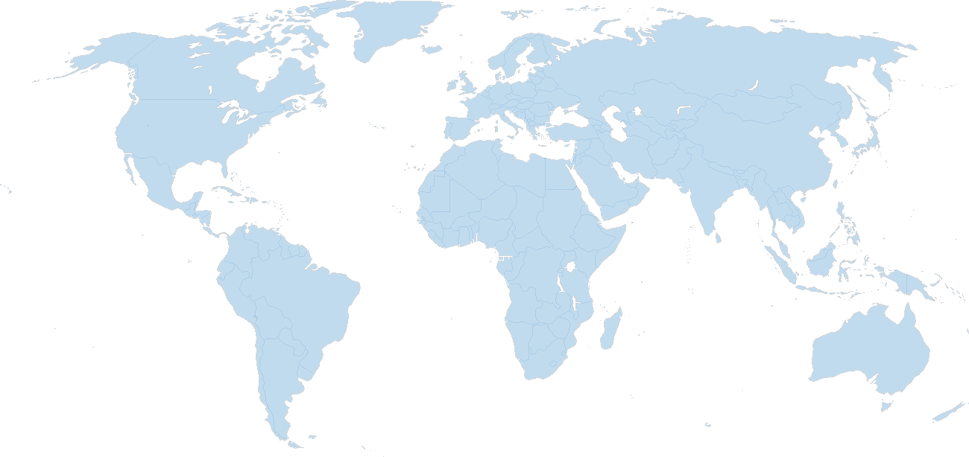

Windows Azure’s Global Presence
North America Region
Europe Region
Asia Pacific Region
West – U.S. Sub-Region
East – U.S. Sub-Region
N. Europe
Sub-Region
W. Europe
Sub-Region
N. Central – U.S. Sub-Region
S. Central – U.S. Sub-Region
E. Asia Sub-Region
S.E. Asia
Sub-Region
Major datacenter
CDN node
Notes:
Windows Azure has datacenters in 8 locations (4 in the USA, 2 in Europe and 2 in the Asia pacific region) which allows us to provide services in 83 countries around the world.

Slide 15
Portal Tour
Notes:
Do you like tours?

Slide 16
Product Portal Tour : http://www.WindowsAzure.com Management Portal Tour: http://manage.WindowsAzure.com
Notes:
Judge a cloud provider by its portal interface

Slide 17
What is Windows Azure Web Sites?
Notes:
Do you like tours?

Slide 18
Windows Azure Web Sites enable the full life-cycle delivery of modern Web applications on the Microsoft cloud.

Slide 19



Windows Azure
Your Datacenter
Virtual Machines
Cloud Services
Web Sites
Applications
Applications
Applications
Applications
Data
Data
Data
Data
Firewall
Firewall Rules
Firewall Rules
Network
Virtual Network
Virtual Network
O/S
O/S
Virtualization
Hardware
Focus on the Application
Notes:
Slide Objectives:
Explain the differences between traditional self-hosting and the three options of Windows Azure hosting.
Notes:
In a traditional environment you must manage the full stack. With Windows Azure you can choose a variety of options depending on your needs.

Slide 20

Windows Azure Web Sites
powerful web sites in seconds
start simple
code smart
go live
start free, scale up and out as you go, friction-free and without the headaches
with classic asp, asp.net, php or node.js, develop on Windows, OSX or Linux
deploy live in seconds, easily monitor performance, rapidly diagnose and fix issues
Notes:
Slide Objectives:
Explain how Windows Azure websites are simple, easy, and open.
Notes:

Slide 21
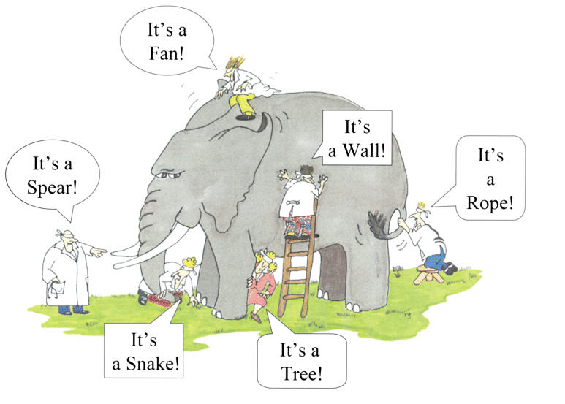
What is it about?
?
?
?
?
?
?
Image Source: http://australianinathens.blogspot.com/2010/05/truth-is-elephant.html

Slide 22
It’s about simplicity

Slide 23
Fast deployments with Web App Gallery

Slide 24
It’s about dev. tools

Slide 25
WebMatrix Visual Studio

Slide 26
It’s about web apps

Slide 27
CMS Deployment

Slide 28
It’s about scale

Slide 29
Quick Scale

Slide 30
It’s about availability

Slide 31
Click here for SLAs
99.9% availability

Slide 32
Deploy to multiple datacenters

Slide 33
It’s about choice of languages
Notes:
<?php
phpinfo()
?>

Slide 34
Deploy PHP web app

Slide 35
It’s about agility

Slide 36
Continuous Integration with Dropbox

Slide 37
It’s about Flexibility

Slide 38
Zero lock in
Hosted and private cloud
Public cloud
Windows Azure Pack
Windows Azure web sites
IIS
Web server
Notes:
Lock in is a major concern in the cloud. We have a great story here…

Slide 39
Windows Azure Pack
http://technet.microsoft.com/en-us/library/dn296435.aspx
http://blogs.technet.com/b/privatecloud/archive/2013/12/06/windows-azure-pack-installing-amp-configuring-series.aspx

Slide 40
Cost?

Slide 41
It’s free to start, but…

Slide 42
 | Free | Shared | Standard
Price | Free | 33% discount in Preview $0.013/hour (~$10/month) | At GA: $0.10/hour per CPU Small: 1 CPU Medium: 2 CPUs Large: 4 CPUs
Number of sites | Up to 10 per Region (60) | Up to 100 | Up to 500
Maximum scale | 1 instance | 6 instances | 10 instances
Scale-out | Not supported | Scale-out up to 6 instances | Scale-out up to 10 instances
Scale-up | Not supported | Not supported | Small, Medium, and Large instance types
Auto-scale | Not supported | Not supported | Supported
Storage | 1GB (shared by all sites) | 1GB (shared by all sites) | 10GB (shared by all sites)
Storage transactions | 1 hour/day 2.5 minutes for every 5 minutes enforcement period. Shared by all sites in a region | 4 hours / day. 2.5 minutes for every 5 minutes enforcement period per site | Full resources on box
SQL database | 1 GB for all sites in a region. Enforced once an hour | 512MB per site. Enforced once an hour | Full resources on box
MySQL (via ClearDB) | Standard SQL Database | Standard SQL Database | Standard SQL Database
Database Storage | Includes one 20MB database | Includes one 20MB database. Can purchase additional in Windows Azure Store. | Includes one 20MB database. Can purchase additional in Windows Azure Store.
Data Transfer | Ingress - Unlimited Egress - 165MB/day (5GB/month) | Ingress – Unlimited Egress – Windows Azure bandwidth rates (above 5GB/month) | Ingress – Unlimited Egress – Windows Azure bandwidth rates (above 5GB/month)
Custom domains | Not Available | CNAME and A-Record | CNAME and A-Record
SSL | Not Available | Available | Available
SLA | Not Available | Not Available in Preview | 99.9% Monthly
Support | None | None in Preview | Available
Notes:
http://www.windowsazure.com/en-us/pricing/details/web-sites/

Slide 43
Click here for latest pricing…

Slide 44
Yeah! now I get it.
Simplicity
Flexibility
WebApps
Tools
Choice
Scale
Image Source: http://australianinathens.blogspot.com/2010/05/truth-is-elephant.html

Slide 45
What is it best suited for?

Slide 46
Best for standalone web apps & web services

Slide 47
Digital Campaigns
Social Apps
Gaming front-ends
Mobile App supporting services
Corporate websites
Brand websites
Multiple blogging sites

Slide 48
What is it not about?

Slide 49
Background Services (e.g. Windows Services)
Operating System Access
File System Access
Unsupported programming languages
Web App Memory/CPU > VM Limits

Slide 50
How does it work?

Slide 51

Web Sites architecture
All DBs are running on SQL Azure.
Azure blobs as durable storage.
Windows Azure worker roles.
Monitor resources usage.
Dynamic web activation service.
W3WP.exe IIS application pool process.
IIS ARR (LB)
Web server
Site (W3WP.exe)
Web Sites DB’s
Runtime DB
Metering
DWAS
Deployment server(s)
Azure LB
Storage controller
Cloud drive
API frontend

Slide 52
Serving HTTP(s) Traffic – Inactive Site (‘cold’ site)
Azure LB
API endpoint
WebWorker
WebWorker
WebWorker
Site DB
Site DB
Site DB
http://site1..../
WebWorker
Site DB
Site DB
Site DB
HTTP
Frontend
(IIS ARR)
SQL Azure / MySQL / Mongo
Runtime DB
SQL Azure
VHD blobs
Publish endpoint
File Server

Slide 53
Serving HTTP(s) Traffic – Inactive Site (‘cold’ site)
Azure LB
API endpoint
WebWorker
http://site1..../
Site DB
HTTP
Frontend
(IIS ARR)
site1
site1
SQL Azure
Runtime DB
SQL Azure
VHD blobs
Publish endpoint
File Server

Slide 54
Serving HTTP(s) Traffic – Active Site (‘hot’ site)
Azure LB
API endpoint
WebWorker
WebWorker
WebWorker
Site DB
Site DB
Site DB
http://site1..../
WebWorker
Site DB
Site DB
Site DB
HTTP
Frontend
(IIS ARR)
site1
SQL Azure
Runtime DB
Metering DB
SQL Azure
VHD blobs
Publish endpoint
File Server

Slide 55
Module summary
Scalable, secure and flexible platform for building and hosting powerful web applications.
Ready for business.
Web scale world wide.
Best Visual Studio Experience.
Faster to market.
Open and flexible.

Slide 56
02 | Know Thy Tools
James Chambers | Microsoft MVP in Asp.Net/IIS
Tejaswi Redkar | Author, Director of Business Programs (AppPlat)

Slide 57
Module Overview
Let the Frameworks Decide Your Toolset
The Windows Azure SDK
Various Development Environments
Windows Azure Command Line Tools & PowerShell

Slide 58
Let the Frameworks Decide Your Toolset
Notes:
Do you like tours?

Slide 59




Supported Web Frameworks
Or any custom FastCGI Handler
Notes:
Slide Objectives:
Explain that Windows Azure Web Sites supports Classic ASP, ASP.NET, PHP, and Node.js out of the box and that you can also host any custom FastCGI handler.
Notes:
Python in there too!

Slide 60
Bring Your Own Tools!
What environment are you comfortable working in?
Use it!

Slide 61
The Windows Azure SDK
Notes:
Do you like tours?

Slide 62
The Windows Azure SDK
First step for any Windows Azure development
Includes libraries needed to access Windows Azure features and give you automation capabilities
http://www.windowsazure.com/en-us/downloads/

Slide 63
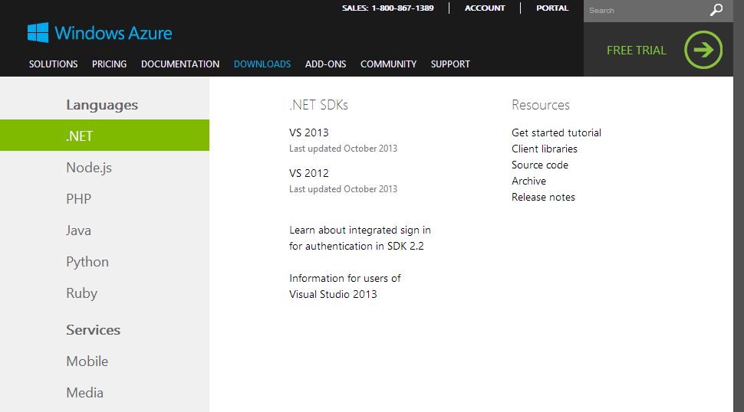

Slide 64
Various Development Environments
Notes:
Do you like tours?

Slide 65
Your Development Environment Of Choice
Any environment that can be extended to support Git
Any environment that supports Git natively
The contenders:
The underdog
The heavyweight
The rookie sensation
Notes:
Examples of extending an environment: Eclipse with PHP and EGit

Slide 66

Web Matrix for Windows Azure
Freely available
Context-specific
Multi-language support
Great for PHP and Node.js development
Some great starter templates

Slide 67
Web Matrix – The Underdog

Slide 68
Visual Studio 2013
Feature-rich web & cloud development environment
Full support for HTML 5, CSS3, JavaScript and jQuery
Great tools like Browser Link and Page Inspector
Integrated source control management
Built-in controls, debugging and trace logging for Windows Azure Web Sites

Slide 69
Visual Studio 2013 – Extensibility
Microsoft and third-party-provided plugins
Rich NuGet support native to the IDE
Great extensions such as http://vswebessentials.com/
Not just for .Net languages
Excellent support for Node.js development through NTVS
https://nodejstools.codeplex.com
“Best of Both Worlds” using node.exe to run, V8 to profile and then VS to do things like provide performance metrics in a familiar format
Python, Django, TypeScript – all have support via separate downloads

Slide 70
Visual Studio 2013 – The Heavyweight

Slide 71
Visual Studio Online “Monaco”
New! New! New!
Completely online experience provided through the Windows Azure portal
Great for small teams
Low cost to start
Really well suited for a workbench
Notes:
Low cost: free users/sites up to 5/10 for VSO/WAWS

Slide 72
Visual Studio Online – The Rookie Sensation

Slide 73
Windows Azure Command Line Tools & PowerShell
Notes:
Do you like tours?

Slide 74
Beyond the IDE
PowerShell cmdlets
Cross-platform command line tools
Notes:
Get full control over create, update, delete, state management (start, stop, restart)

Slide 75
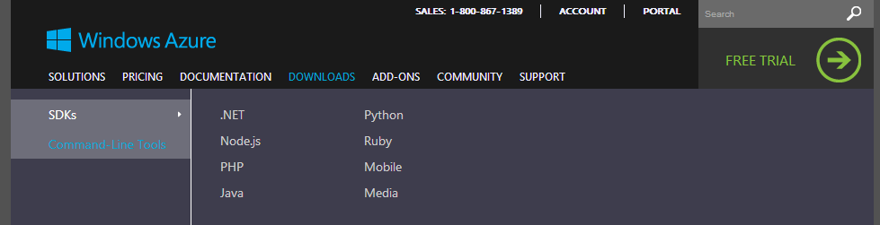
Grab the Downloads

Slide 76
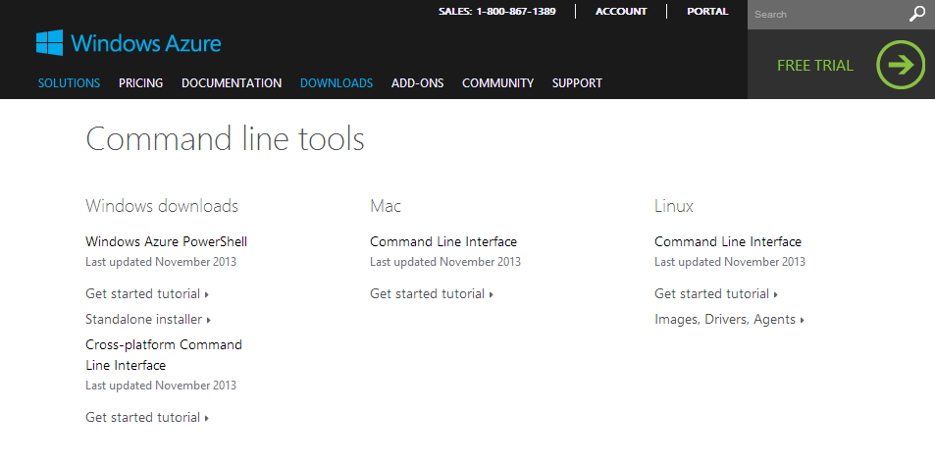
Grab the Downloads

Slide 77
Dive In!

Slide 78
PowerShell Script Samples
# Restart all acceptance test sites
Get-AzureWebsite |
Where-Object { $_.Name -like "*acceptancetest*" } |
ForEach-Object { Restart-AzureWebsite $_.Name }

Slide 79
PowerShell Script Samples
#push a GitHub repo to a randomly created host
param( [string] $SiteName=[guid]::NewGuid().ToString(), [parameter(Mandatory=$true)] [string] $FullPath )
Push-Location cd $FullPath
$createData = New-AzureWebsite $siteName –GitHub $createData.HostNames[0]
Pop-Location Set-Location
# pause for dramatic suspense (...and git deployment) and display site Start-Sleep 30 Show-AzureWebsite $SiteName

Slide 80
PowerShell Script Samples
# create and push settings to your site
$settings = @{ "best-fruit" = "bananas";| "better-fruit" = "grapes"; "good-fruit" = "kiwi“ }
Set-AzureWebsite YourWebSite -AppSettings $settings

Slide 81
PowerShell Script Samples
# grab the existing settings, add and post back
$settings = (Get-AzureWebsite YourWebSite).AppSettings $settings.Add("worst-fruit", "tomatoes") Set-AzureWebsite YourWebSite -AppSettings $settings
# grab the existing settings, modify and post back
$settings = (Get-AzureWebsite YourWebSite).AppSettings $settings.Set_Item("worst-fruit", "dried prunes") Set-AzureWebsite YourWebSite -AppSettings $settings
Notes:
Using a ‘pull-update-push’ pattern
This works for all items in a similar fashion like for connection strings

Slide 82
Module Summary
Discussed compatible web application frameworks
Looked at some of the more common development environments for Windows developers
Explored some command line alternatives for those working on other stacks

Slide 83
03 | Continuous Deployment
James Chambers | Microsoft MVP in Asp.Net/IIS
Tejaswi Redkar | Author, Director of Business Programs (AppPlat)

Slide 84
Module Overview
A Bit of Background…
Understanding the Internal Deployment Engine
Visual Studio Online Integration
Git Integration
Exploring a Continuous Deployment Strategy

Slide 85
A Bit of Background…
Notes:
Do you like tours?

Slide 86
Why Use Continuous Deployment?
Compliments automated testing
Rapid delivery to test environments
Lowers risk as part of a CI strategy

Slide 87



Role for Windows Azure Web Sites With CD
start simple
code smart
go live

Slide 88
Start Simple
Easily create new sites
Manage and scale your sites as required, or via automated means
Automatic load balancing and shared storage across instances
Ideal target for test environments, too!

Slide 89
Code Smart
Use the language and tooling of your choice
Use your SCM as a gateway with automated testing
Trigger deployments from a simple check-in

Slide 90
Go Live
“Hands off” or “Hands on” deployment
Integrated source control with Team Foundation Server (TFS), Git, Mercurial and popular DSCM services
Benefits of management, monitoring, reliability and scalability over self-hosted environments

Slide 91

Supported Publishing Methods
FTP://
VS Online
WebDeploy
DropBox
Notes:
Git Deployment is Native, or through a Service hook from CodePlex, GitHub or BitBucket

Slide 92




OOB Supported Service Hooks
Notes:
Git Deployment is Native, or through a Service hook from CodePlex, GitHub or BitBucket
Ideal for open source projects

Slide 93
Understanding the Deployment Engine
Notes:
Do you like tours?

Slide 94
What’s Happening in the Background?
Kudu – an internal deployment engine – “watches” for check-ins
An automated build is completed
KuduSync kicks in
The deployment is created in your website’s folder structure
The new deployment is copied to your site’s root, leaving old deployments intact
Notes:
Build occurs on TFS
Difference: TFS builds your solution, Kudu does a minimal build to build your project

Slide 95
More on Kudu
It’s an open source project available on GitHub
Automatically installed on all Windows Azure Web Sites
Can use a custom deployment script
Notes:
Build occurs on TFS
Difference: TFS builds your solution, Kudu does a minimal build to build your project
Custom deployment script: execute whatever logic you need it to, unit tests, file operations, custom notifications, either in a bat/bash file or in a library you’ve included

Slide 96
Exploring a Visual Studio Online Deployment

Slide 97
Using GitFlow

Slide 98
Deployment Sugar – Service Hooks
Executed whenever a deployment via Git, Mercurial or DropBox is completed
Retrieved from your configuration settings in the dashboard
Can participate in trigger-action scenarios

Slide 99
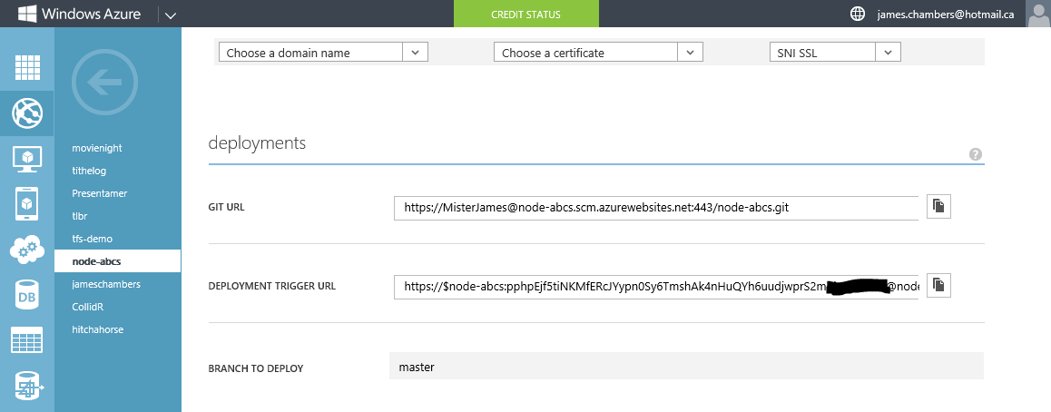

Slide 100
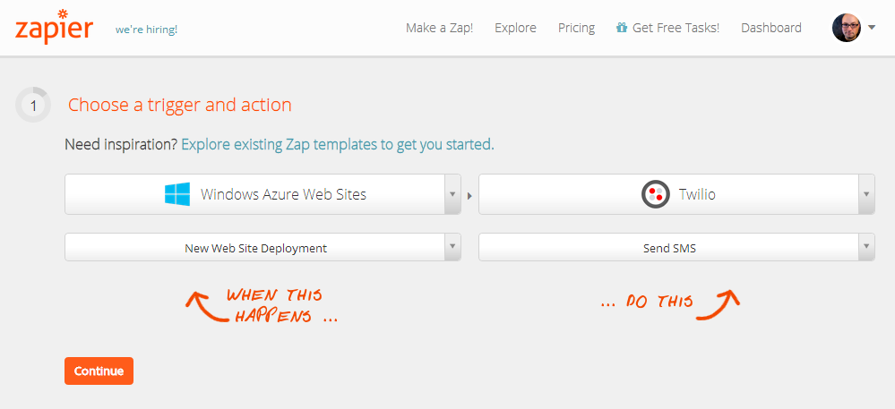

Slide 101
Module Summary
Looked at when to use continuous delivery and why you would
Considered the tech, tools and options in play
Examined a couple of scenarios with hosted SCM

Slide 102
04 | Scaling and Configuration
James Chambers | Author, Microsoft ASP.NET/IIS MVP
Tejaswi Redkar | Author, Director of Business Programs (AppPlat)

Slide 103
Module Overview
The Hosting Plans
Scaling
Scale-Up
Scale-Out
Scale-out patterns
Monitoring & Diagnostics
Custom Domains & SSL
Configuration Settings

Slide 104
Scaling

Slide 105
Scaling Out and Scale-Up (Standard)
Scale Up
Only available in Standard-tier
In Standard tier - increase the size of a reserved instance
Scale Out
In Shared tier - add more instances of your app
In Standard tier – add more reserved instances (VMs)

Slide 106

scale
Free
Multi-tenant. Daily quotas
Shared
Multi-tenant. Daily quotas
Standard
Dedicated VMs. No quotas
Notes:
Slide Objectives:
Explain the three scale choices on Windows Azure Web Sites.
Notes:
Both free and shared are the same architecture. With standard you isolate your application to your own virtual machines that you can use and pay for whatever resources you choose.
Online Resources:
If you’d like more details on Web Site pricing and quota, see the Windows Azure pricing page here: http://www.windowsazure.com/en-us/pricing/details/web-sites/

Slide 107
 | Free | Shared | Standard
Price | Free | 33% discount in Preview $0.013/hour (~$10/month) | At GA: $0.10/hour per CPU Small: 1 CPU Medium: 2 CPUs Large: 4 CPUs
Number of sites | Up to 10 per region (10 x 6 regions) | Up to 100 per region | Up to 500 per region
Maximum scale | 1 instance | 6 instances | 10 instances
Scale-out | Not supported | Scale-out up to 6 instances | Scale-out up to 10 instances
Scale-up | Not supported | Not supported | Small, Medium, and Large instance types
Auto-scale | Not supported | Not supported | Supported
Notes:
http://www.windowsazure.com/en-us/pricing/details/web-sites/

Slide 108
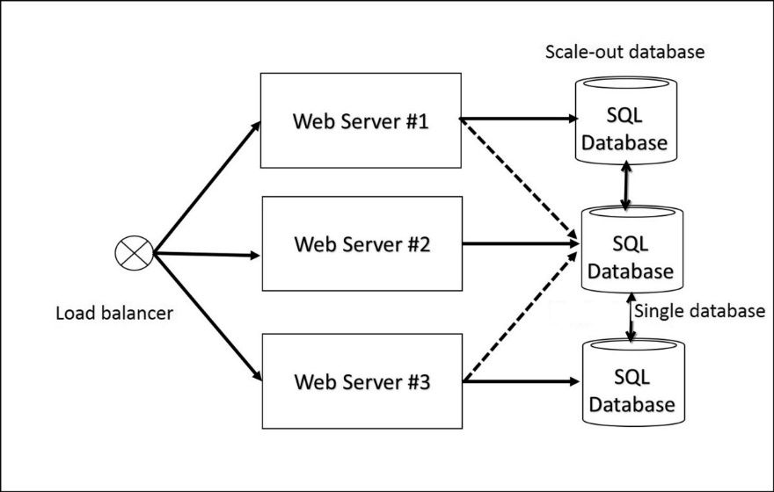
Scale-Out
Be careful of two issues:
Session Management
Database Bottle-neck

Slide 109
Scale Out – Things To Remember
ARR Affinity cookie
By default, requests go to the same server
http://blogs.msdn.com/b/windowsazure/archive/2013/11/18/disabling-arr-s-instance-affinity-in-windows-azure-web-sites.aspx
Stateless app running on WAWS
Remove ARR Affinity cookie
Manage session state (DB, Cache, Client Cookies, etc…)
Database is the bottleneck
Distributed Cache (covered later)
Storage Object Distribution pattern (covered later)

Slide 110
Scaling

Slide 111
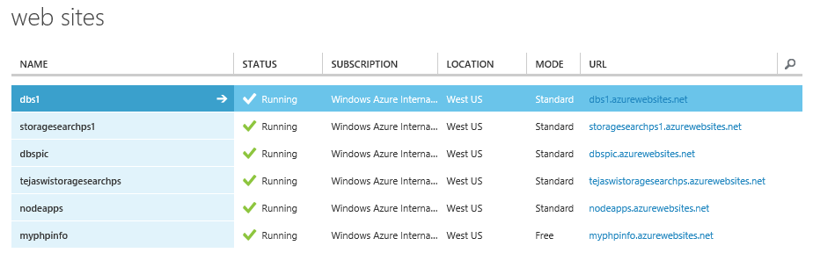
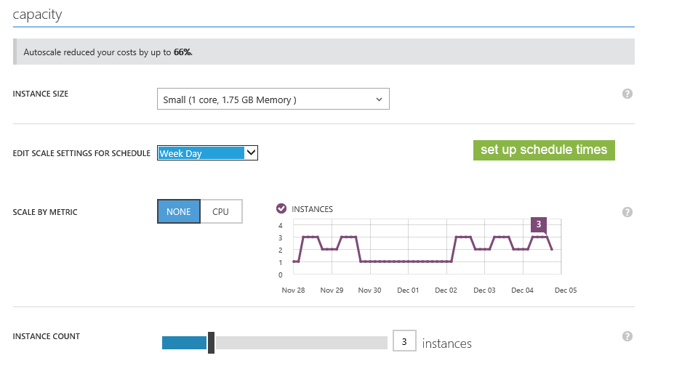

Slide 112
Scale-out my website to 3 instances when the CPU threshold crosses 80%, and scale-down my website to 1 instance when the CPU threshold goes below that.
Scenario 1: CPU-Only Scaling

Slide 113
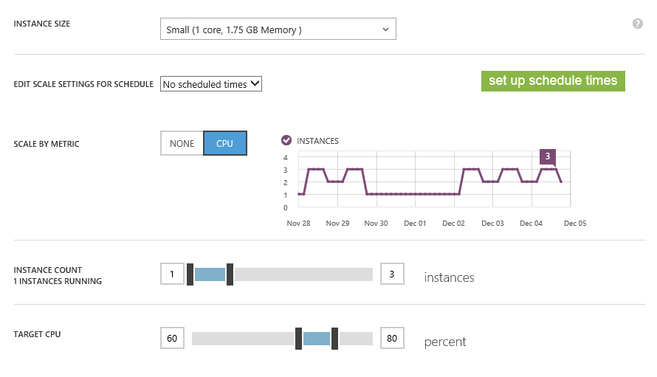

Slide 114
Scenario 2: Schedule-based Scaling
Run 3 instances during week days
Run 1 instance during week nights
Increase it to 2 if CPU >= 80%
Run 1 instance during weekends

Slide 115
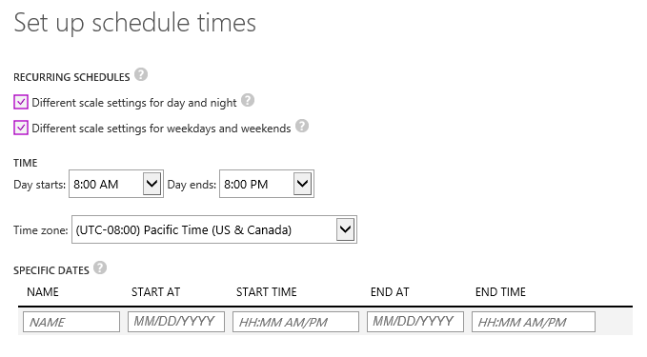

Slide 116
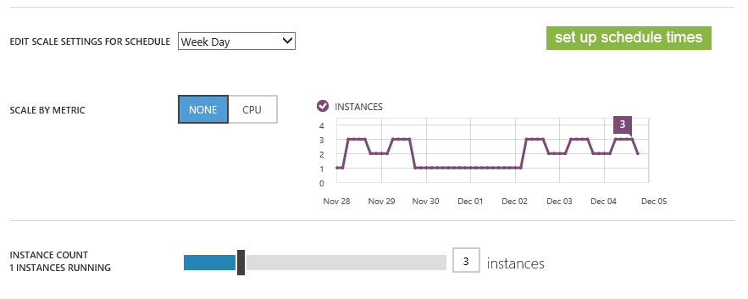

Slide 117
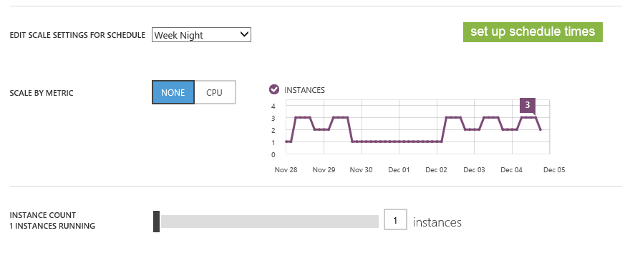

Slide 118
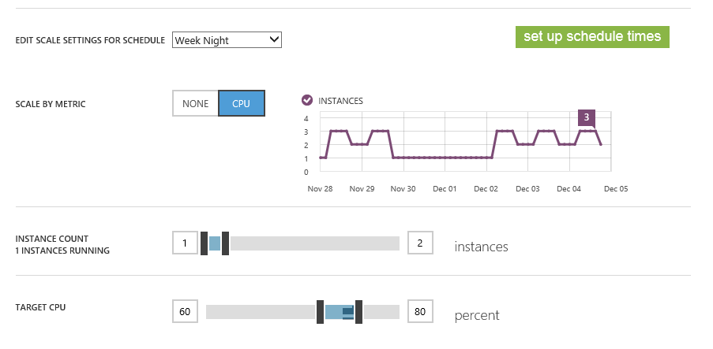

Slide 119
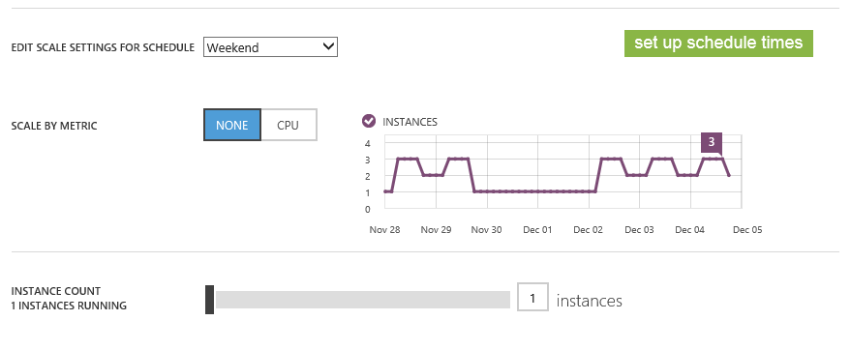

Slide 120
Cache Static Content
<?xml version="1.0" encoding="UTF-8"?>
<configuration>
<system.webServer>
<staticContent>
<clientCache
cacheControlMode="UseMaxAge" cacheControlMaxAge="20.00:00:00" />
</staticContent>
</system.webServer>
</configuration>

Slide 121
Some testing tools
Load Impact: http://www.loadimpact.com
Pingdom: http://tools.pingdom.com
Web Page Test: http://www.webpagetest.org/
Neustar: http://www.neustar.biz/enterprise/resources/web-performance/free-website-performance-test

Slide 122
webpagetest.org

Slide 123
Monitoring

Slide 124
Diagnostics & Monitoring
HTTP Logs
Error Logs
Portal Monitoring
Log Streaming
New Relic

Slide 125
Metric | Description
CPUTime | The website’s CPU usage
Data In | Data received by the website from clients
Data Out | Data sent by the website to the clients
Requests | The total number of requests handled by the website
HTTP Server Errors | Number of HTTP internal server errors
HTTP Successes | Number of HTTP success messages sent
HTTP Redirects | Number of HTTP redirect messages sent
HTTP Client Errors | Number of HTTP client error messages
HTTP 401 errors | Number of HTTP 401 Unauthorized messages
HTTP 403 errors | Number of HTTP 403 Forbidden messages
HTTP 404 errors | Number of HTTP 404 Not Found messages
HTTP 406 errors | Number of HTTP 406 Not Acceptable messages.

Slide 126
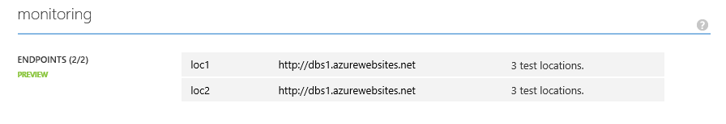
Web Endpoint Monitoring and Alerts

Slide 127
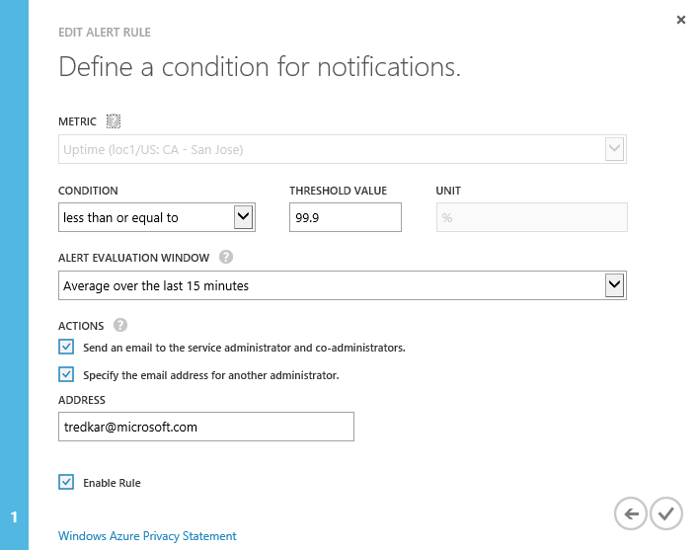
Rules

Slide 128
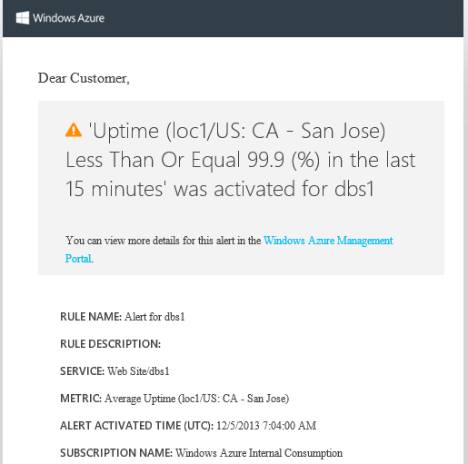
Alerts

Slide 129
Monitoring

Slide 130
Logging

Slide 131
Enable Logging
Application Diagnostics
Site Diagnostics

Slide 132
Application Diagnostics
System.Diagnostics.Trace.TraceInformation
(string.Format(
"User logged in {0}", User.Identity.Name));

Slide 133
Site Diagnostics
Web Server Logging
Logs HTTP requests and responses
Detailed Error Logging
Logs detailed error messages for 400 or greater HTTP status codes that indicate a failure.
Failed Request Tracing
Logs traces of failed requests

Slide 134
Retrieving Logs
FTP
Storage Tool
PowerShell
PowerShell Streaming

Slide 135
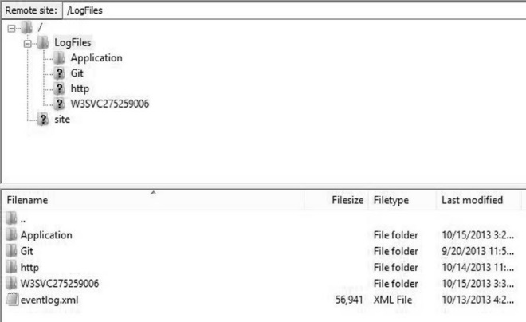
FTP (FileZilla)

Slide 136
Using PowerShell
To download log file using PowerShell:
Start PowerShell command prompt
Import .publishsettings file
>Import-AzurePublishSettingsFile “Path to the .publishsettings file”
Download the logs by calling the cmdlet
Save-AzureWebSiteLog -Name [websitename]
Output is logs.zip

Slide 137
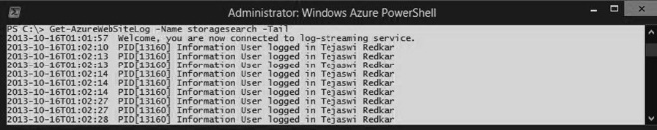
Using PowerShell Streaming
Start PowerShell command prompt
Import .publishsettings file
>Import-AzurePublishSettingsFile “Path to the .publishsettings file”
Download the logs by calling the cmdlet
Get-AzureWebSiteLog -Name [websitename] -Tail

Slide 138
Logging

Slide 139
Custom Domains

Slide 140
Custom Domains
CNAME (aka Alias Record) [Recommended]
Map a domain alias such as www.dynamicdeploy.com to <yourwebsite>.azurewebsites.net domain name
Cannot map bare and wildcard domains
A Record
Map bare domains (dynamicdeploy.com) as well as wildcard domains (*.dynamicdeploy.com) to IP Address

Slide 141
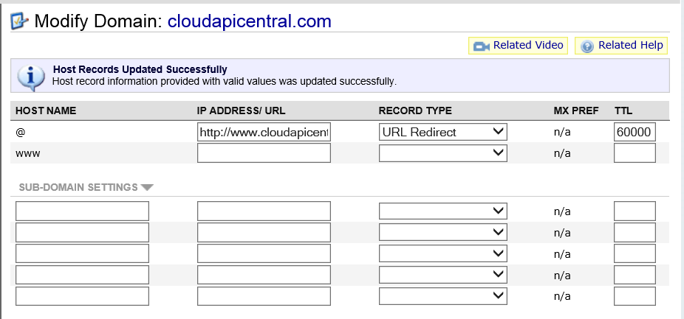
Default Setting (Namecheap.com)

Slide 142
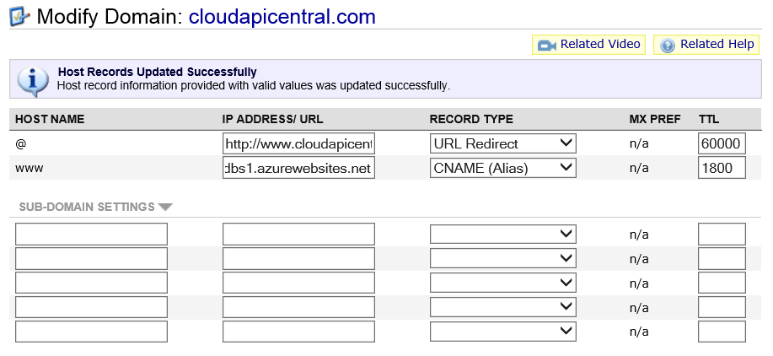
Set CNAME (Namecheap.com)

Slide 143
Track Domain Propagation
http://www.digwebinterface.com/
http://www.dnsstuff.com

Slide 144
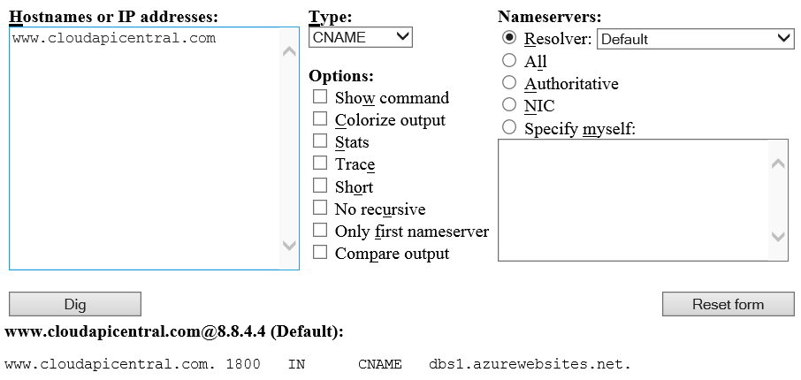
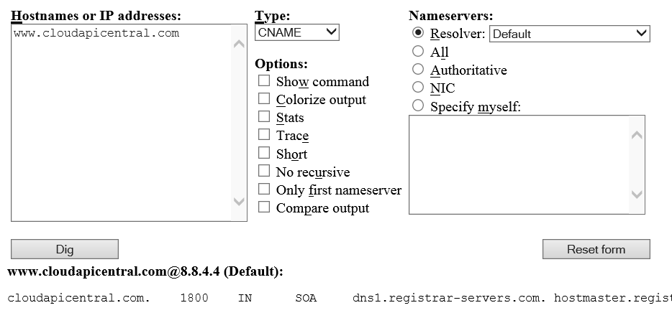
Dig CNAME propagation (Namecheap.com)
http://www.digwebinterface.com

Slide 145
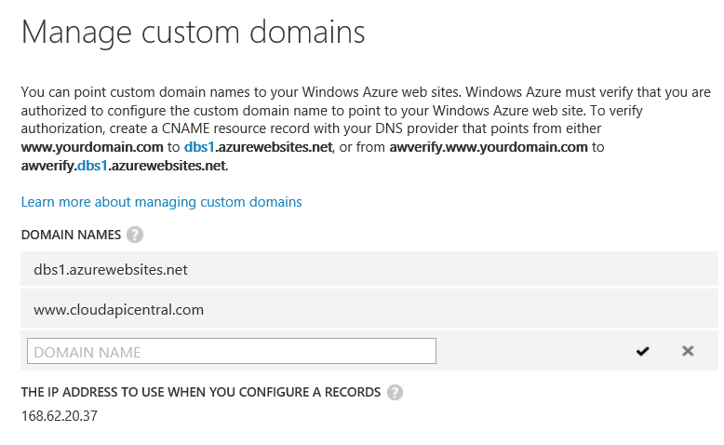
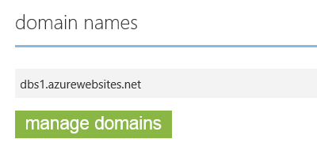
Set CNAME (Namecheap.com)

Slide 146
A Record
Login to your domain name registrar’s website and add the CNAME setting for awverify.[yourwebsitename].azurewebsites.net.
Wait for propagation
Navigate to Windows Azure portal
Click on the Manage Domains link on the Configure tab
Note the IP address of the website that is listed in the dialog box
Login to the domain registrar’s website and add an A record
Add the new domain name (e.g. www.cloudapicentral.com) by clicking on the Manage Domains in the Configure section
Alias | TTL | Type | Value
awverify.cloudapicentral.com | 60000 | CNAME | awverify.storagesearch.azurewebsites.net
cloudapicentral.com | 7200 | A | 137.117.17.70

Slide 147
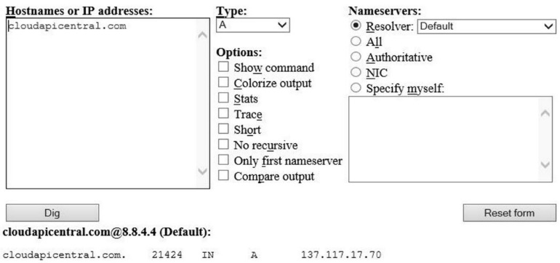
Dig A Record propagation
http://www.digwebinterface.com

Slide 148
Custom Domains (http://www.icontinuous.com )

Slide 149
Secure Socket Layer (SSL)

Slide 150
SSL
SSL = Secure Socket Layer
Establishes encrypted channel between your browser and the web server
Needs a certificate provided by a Certificate Authority (CA)
Get Certificate → Verisign, GoDaddy.com
Self-signed (browser displays warning)

Slide 151
Create a self-signed certificate
makecert.exe -n "CN=%1" -in "Center Root CA" -ss my -e "07/01/2022" -eku 1.3.6.1.5.5.7.3.1 -pe -sky exchange "%~dp0certs\mysslcert.cer" -sv "%~dp0certs\mysslcert.pvk" -len 2048
pvk2pfx -pvk "%~dp0certs\mysslcert.pvk" -spc "%~dp0certs\mysslcert.cer" -pfx "%~dp0certs\mysslcert.pfx" -pi Pass@word1
makecert.exe -n "CN=www.icontinuous.com" -in "Center Root CA" -ss my -e "07/01/2022" -eku 1.3.6.1.5.5.7.3.1 -pe -sky exchange "%~dp0certs\mysslcert.cer" -sv "%~dp0certs\mysslcert.pvk" -len 2048
pvk2pfx -pvk "%~dp0certs\mysslcert.pvk" -spc "%~dp0certs\mysslcert.cer" -pfx "%~dp0certs\mysslcert.pfx" -pi Pass@word1

Slide 152
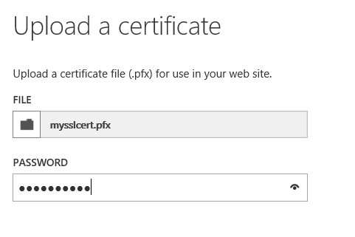
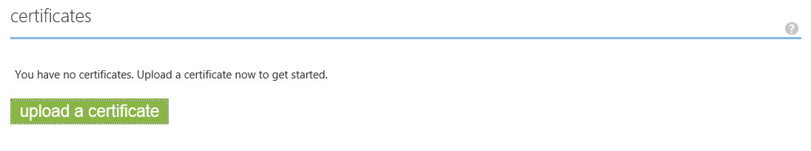
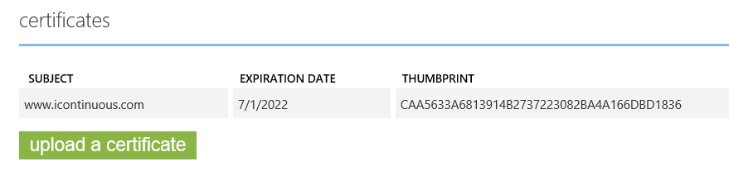
Upload Certificates

Slide 153
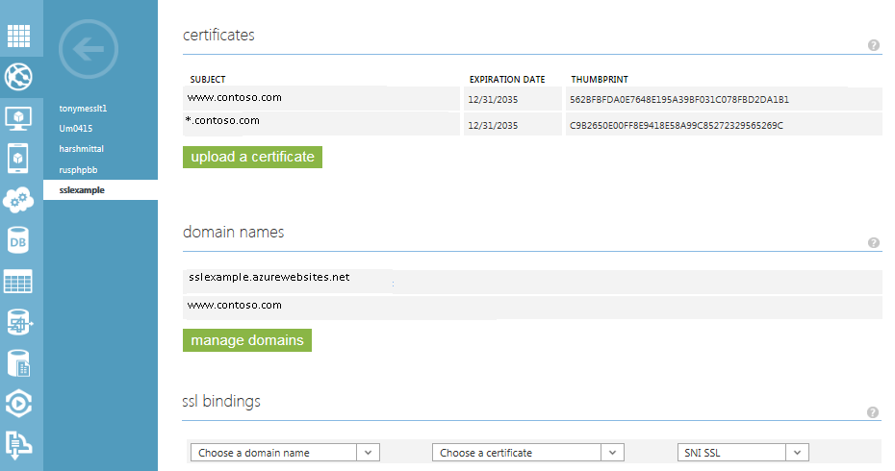
Secure with SSL
IP-based.
Sites can have one certificate configured per IP address and port number.
Server Name Indication (SNI).
SNI based SSL binding allows multiple custom domains to share the same IP address, with separate SSL certificates for each custom domain.

Slide 154
Forcing a website to use SSL
<system.webServer>
…
<rewrite>
<rules>
<clear />
<rule
name="RedirectToHTTPS"
stopProcessing="true">
<match url="(.*)" />
<conditions>
<add input="{HTTPS}"
pattern="off" ignoreCase="true" />
</conditions>
<action
type="Redirect" url="https://{HTTP_HOST}{REQUEST_URI}" redirectType="Permanent" />
</rule>
</rules>
</rewrite>
</system.webServer>

Slide 155
Configuration Settings

Slide 156
Configuration Settings (web.config)
<appSettings>
<add
key="webserviceurl" value="From Local Web" />
</appSettings>
<connectionStrings>
<add
name="databaseconnectionstring" connectionString="Server=(localdb)\v11.0;Integrated Security=true;"/>
</connectionStrings>

Slide 157
Retrieving Configuration Settings in ASP.NET
protected void Page_Load(object sender,
EventArgs e)
{
Literal1.Text+= "webserviceurl=ConfigurationManager.AppSettings
["webserviceurl"]";
Literal2.Text += "databaseconnectionstring=" + ConfigurationManager.ConnectionStrings["databaseconnectionstring"].ConnectionString.Substring(0, 15) + "...";
}

Slide 158
Retrieving Configuration Settings in ASP.NET
You can retrieve the same setting values as environment variables from ASP.NET by using the System.Environment.GetEnvironmentVariable() function as shown below.
Environment.GetEnvironmentVariable
("APPSETTING_webserviceurl");
Environment.GetEnvironmentVariable
("SQLAZURECONNSTR_databaseconnectionstring");

Slide 159
Retrieving Configuration Settings in ASP.NET
Database Type | String to prepend
Windows Azure SQL Database | SQLAZURECONNSTR_
SQL Server | SQLCONNSTR_
MySQL | MYSQLCONNSTR_
Custom | CUSTOMCONNSTR_

Slide 160
Retrieving Configuration Settings in PHP
<?php
$appSetting=getenv("APPSETTING_webserviceurl");
echo $appSetting;
$appSetting=getenv("SQLAZURECONNSTR_databaseconnectionstring");
echo $appSetting;
?>

Slide 161
Retrieving Configuration Settings in Node.js
var http = require('http');
http.createServer(function (req, res) {
res.writeHead(200, { 'Content-Type': 'text/html' });
res.write('Hello, world!');
res.write('<li><label>webserviceurl:</label>' + process.env.APPSETTING_webserviceurl + ' </li>');
res.end('<li><label>databaseconnectionstring:</label>' + process.env.SQLAZURECONNSTR_databaseconnectionstring + ' </li>');
}).listen(process.env.PORT || 8080);

Slide 162
Summary
Scale-up, Scale-out, Auto-scale
Monitoring & Diagnostics
Debugging
Custom Domains & SSL
Configuration Settings

Slide 163
05 | Go Live Checklist
James Chambers | Microsoft MVP in Asp.Net/IIS
Tejaswi Redkar | Author, Director of Business Programs (AppPlat)

Slide 164
Module Overview
Exploring a Sample Project
Building a Checklist
Bringing it Live!
Resources

Slide 165
Our Sample
CloudSurvey from the Windows Azure Training Kit
Follow along with your own copy

Slide 166
Cloud Survey
Notes:
Run through the app and the code

Slide 167
Are Checklists Important? Critical?
Commonly used
Often overlooked as a key tool
Can reduce errors by over 50%

Slide 168
A Typical Web Sites Checklist
Follow Best Practices
Cross-Browser/Device Vetting
Accessibility Concerns
Social Media Integrations
Security Concerns
Notes:
Social media: Facebook insights, open graph, twitter cards
Security: XSS, CSRF

Slide 169
A Windows Azure Web Sites Checklist
Monitoring
Scale for Growth, When Needed
Site Configuration and SQL Firewall Settings
Remote Debugging -> Turned Off
Optionally
Secure the Site
Implement a Continuous Deployment Strategy

Slide 170
Walking the Checklist with Cloud Survey

Slide 171
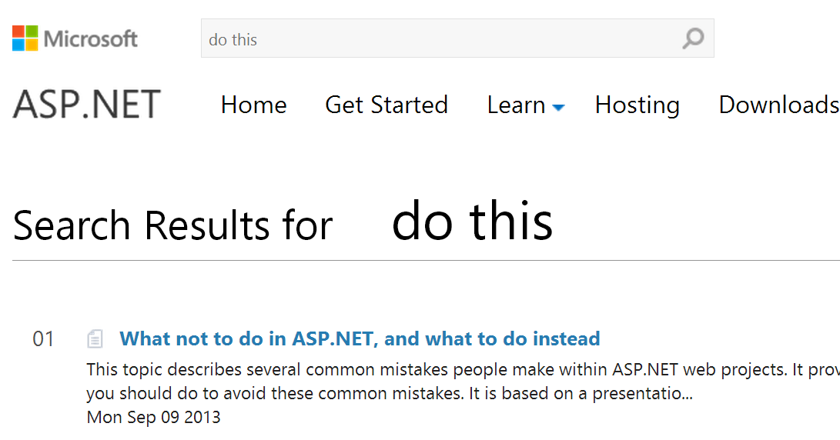
Resources for Developers
http://www.asp.net/aspnet/overview/web-development-best-practices
http://webdevchecklist.com/
https://www.owasp.org/index.php/Cheat_Sheets

Slide 172
Module Summary
The importance of the checklist
Finding your own checklist
Working through an example

Slide 173
06 | Case Studies
James Chambers | Author, Microsoft ASP.NET/IIS MVP
Tejaswi Redkar | Author, Director of Business Programs (AppPlat)

Slide 174
Module Overview
Website Capability Model
Migrating Music Store Web App
Migrating http://www.DynamicDeploy.com

Slide 175
List of core technical capabilities required by a website
Website Capability Model

Slide 176
Identity
Session Management
The mechanism used for storing and sharing session information in a web-farm.
Caching
Data Storage
UX
Runtime
Data Security at rest
Data Security in transit
The authentication and authorization mechanism required by the website.
Specifies caching requirements of a website.
Specifies the relational and non-relational data storage requirements of a website.
User Experience requirements of a website.
Any specific application runtime requirements such as .NET 4.5 or PHP 5.4.
Specifies requirements for securely storing data in relational and non-relational data storage.
Specifies requirements for securely transferring data over the network.

Slide 177
Load-balancing
Scale-up
Specifies the scale-up requirements when scaling a website to meet capacity demand.
Scale-out
Monitoring
Geo-deployment
CDN
Message Bus
Integration
Specifies load-balancing requirements when running a website in a farm
Specifies the scale-out requirements when scaling a website to meet capacity demand.
Specifies the monitoring requirements for operating a website
Specifies the requirement for deploying a website in multiple data centers around the world.
Specifies the requirement for caching static content in a CDN.
Specifies whether a website requires to communicate with a message bus.
Specifies any integration and external API dependencies of a website.

Slide 178
Configuration Management
Search
Specifies the search functionality requirement of a website.
Analytics
E-commerce
Specifies how and where the configuration of a website is managed.
Specifies if a website needs to track usage analytics.
Specifies the E-commerce requirements for a website.

Slide 179
Case Study: Music Store Website

Slide 180
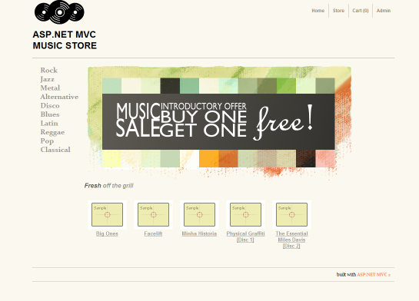
An E-commerce SAMPLE website http://mvcmusicstore.codeplex.com/

Slide 181
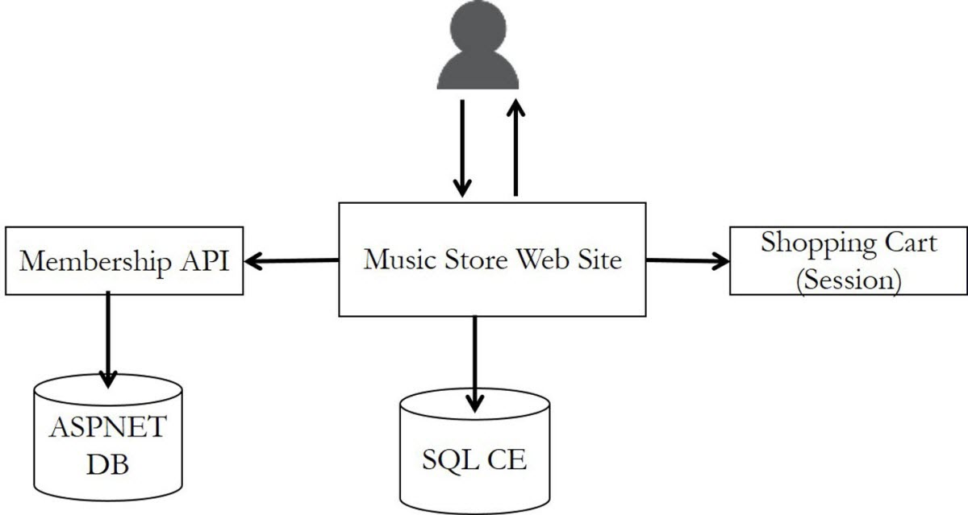
Architecture

Slide 182
How do we take this live on WAWS?

Slide 183
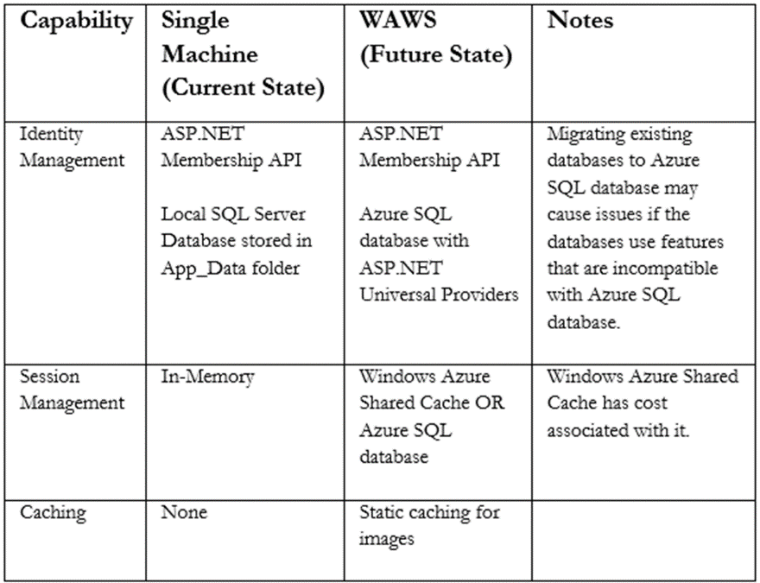
Website Capability Model for Music Store

Slide 184
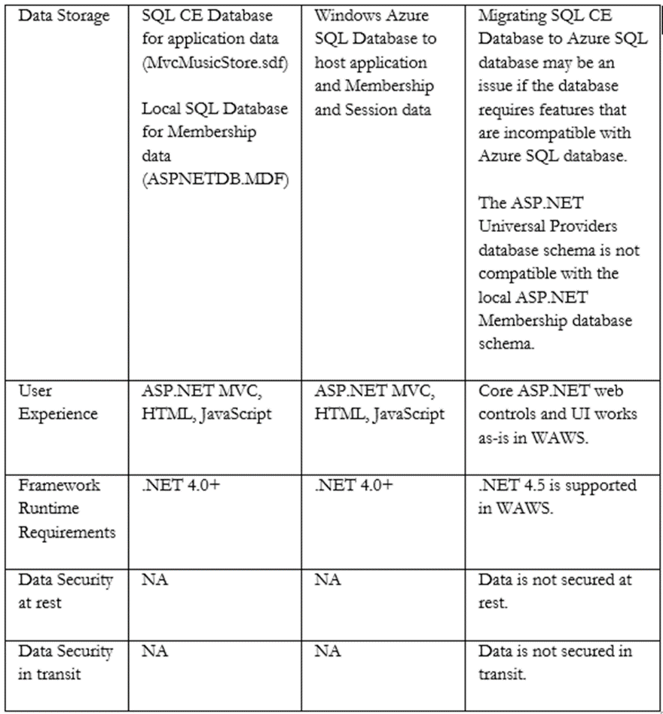
Website Capability Model for Music Store

Slide 185
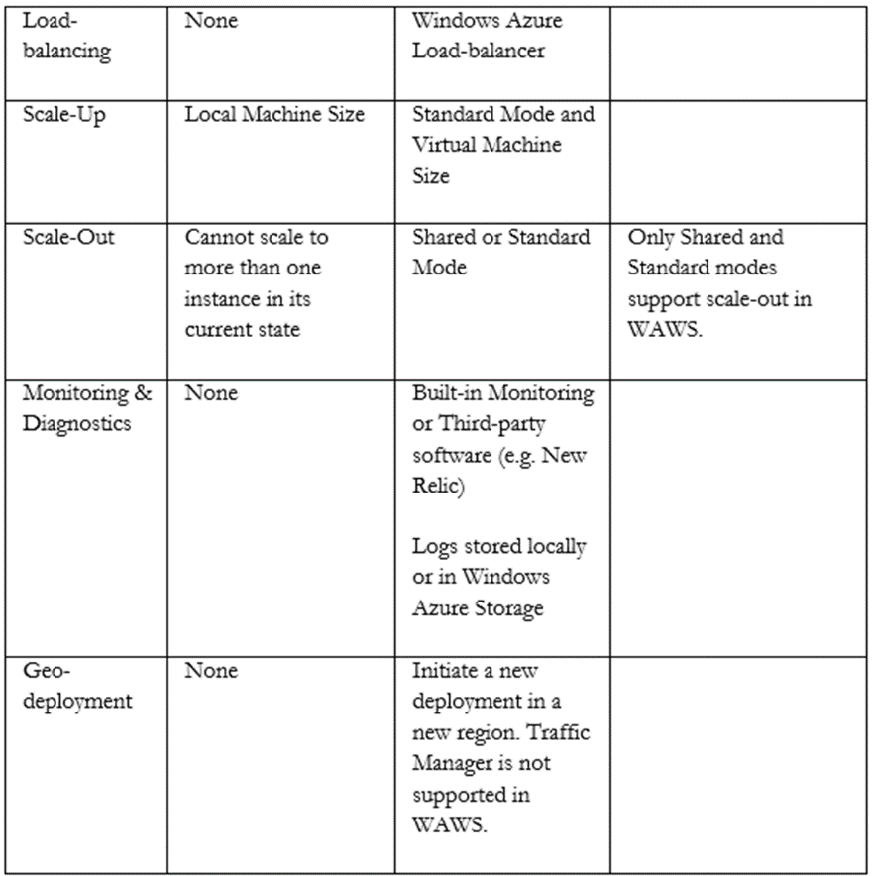
Website Capability Model for Music Store

Slide 186
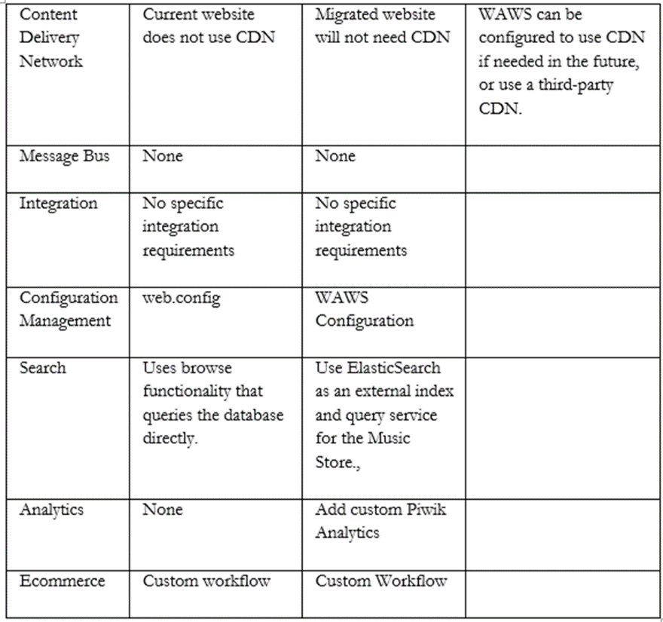
Website Capability Model for Music Store

Slide 187
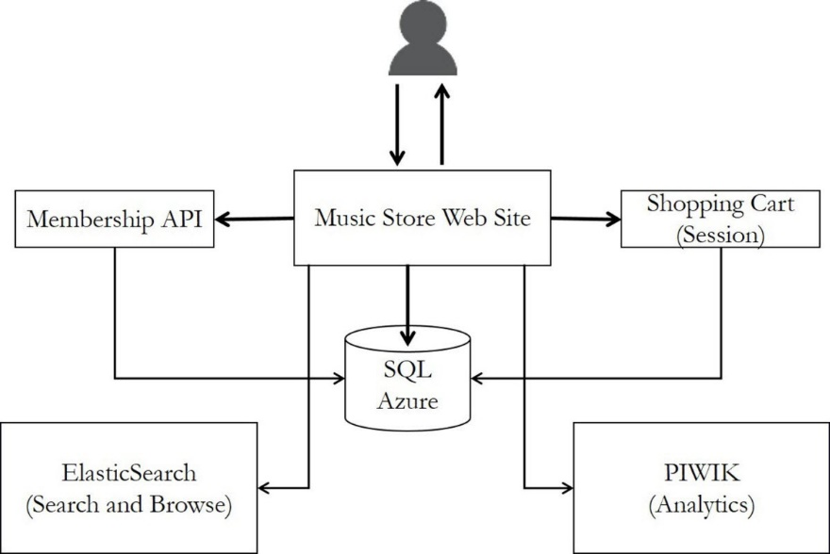
Future State Architecture

Slide 188
Migration Activities
Migrating Databases (the 800 pound Gorilla)
Application Database
Membership Database
Enable Session Management
Adding ElasticSearch support
Adding Custom Analytics with PIWIK

Slide 189
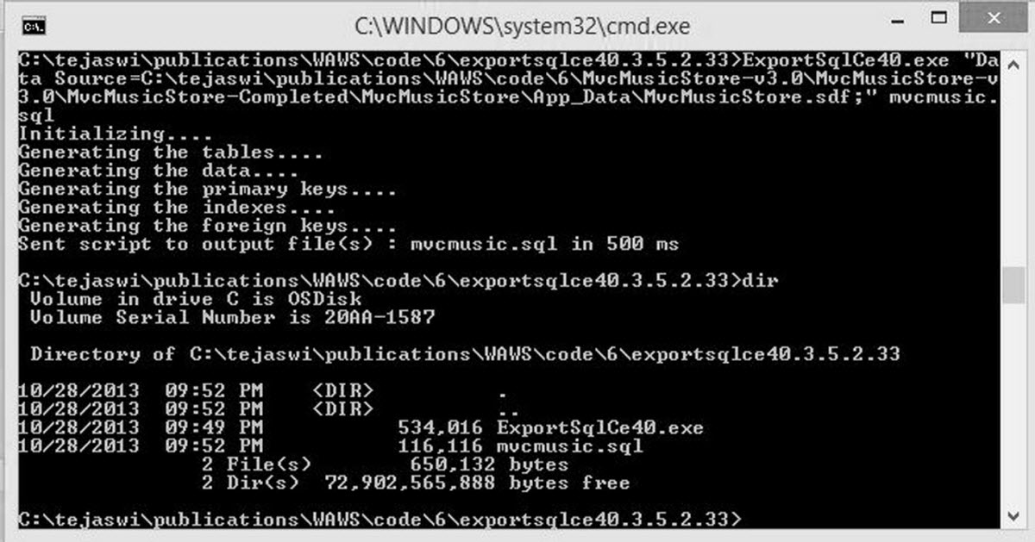
Migrating Application Database to Azure SQL
1) MvcMusicStore.sdf
2) ExportSQLCE Tool (exportsqlce40.3.5.2.33.zip )
http://exportsqlce.codeplex.com/
>ExportSqlCe40.exe "DataSource=C:\musics\App_Data\MvcMusicStore.sdf;" mvcmusic.sql

Slide 190
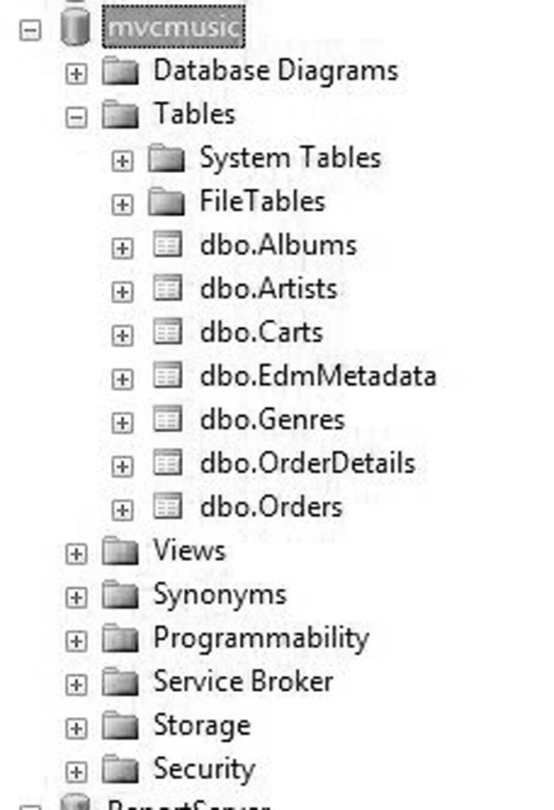
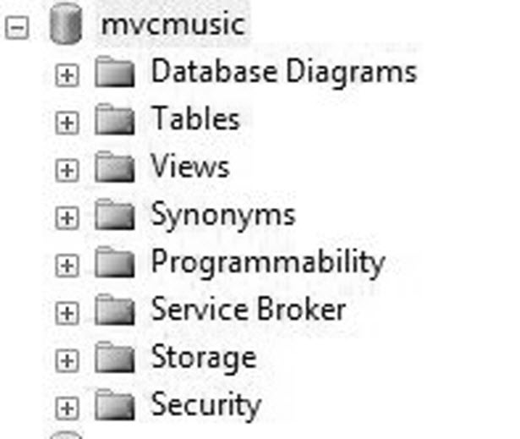
Migrating Application Database
3) Create a new local SQL Server database (mvcmusic) and load the data in the tables

Slide 191
POP QUIZ: Why not load directly into a Windows Azure SQL database?
Msg 40054, Level 16, State 1, Line 1
Tables without a clustered index are not supported in this version of SQL Server. Please create a clustered index and try again.

Slide 192
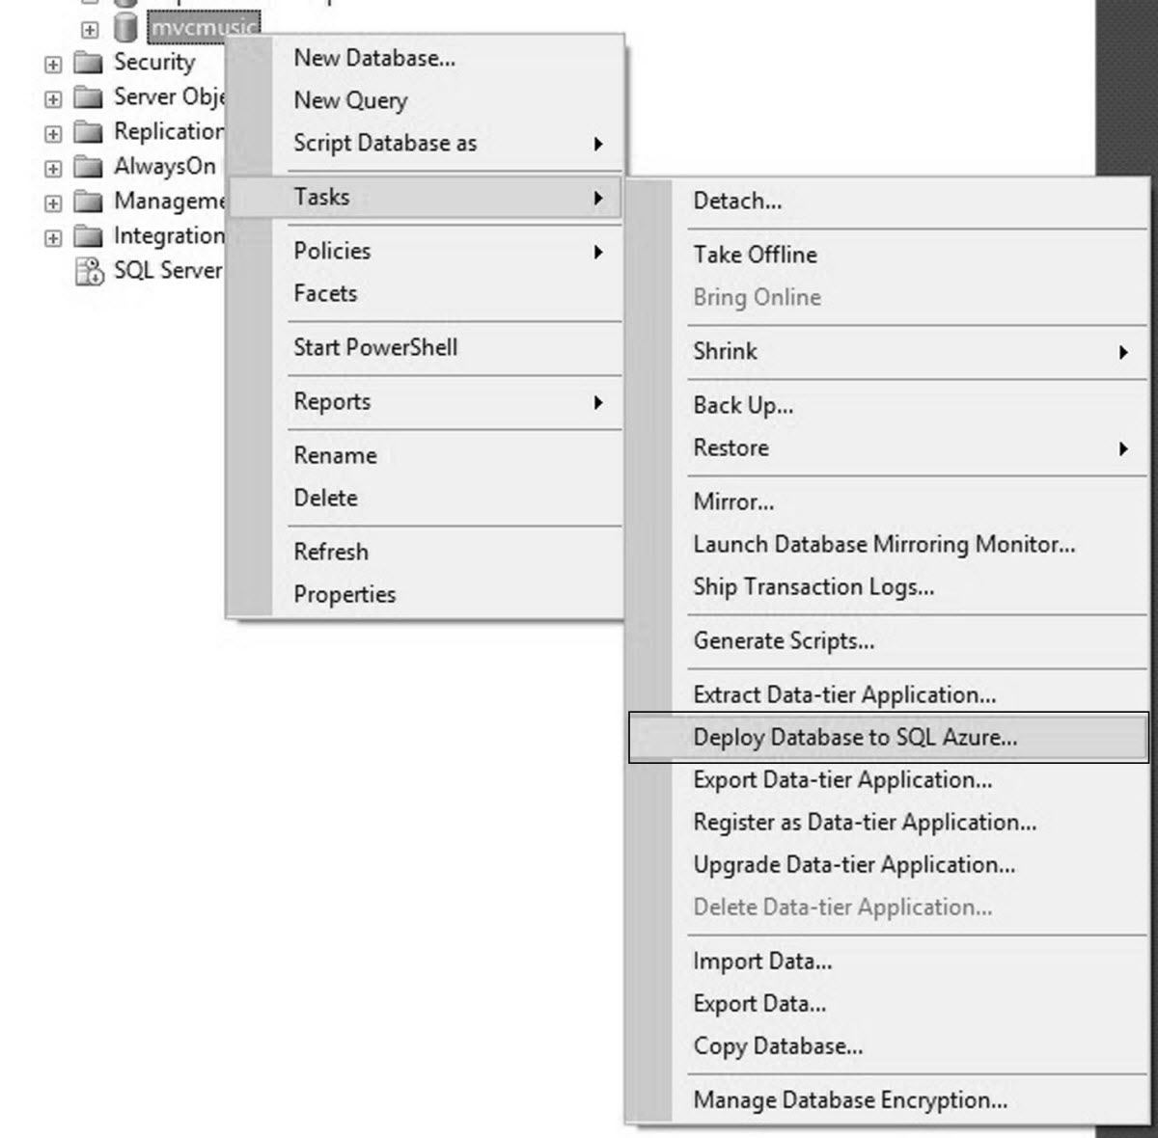
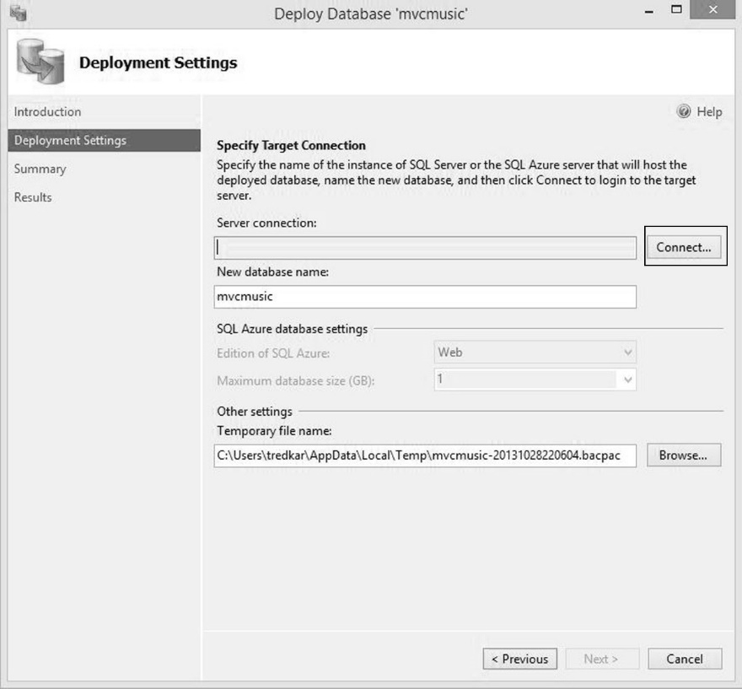
Migrating Application Database
4) Deploy database to Azure SQL database

Slide 193
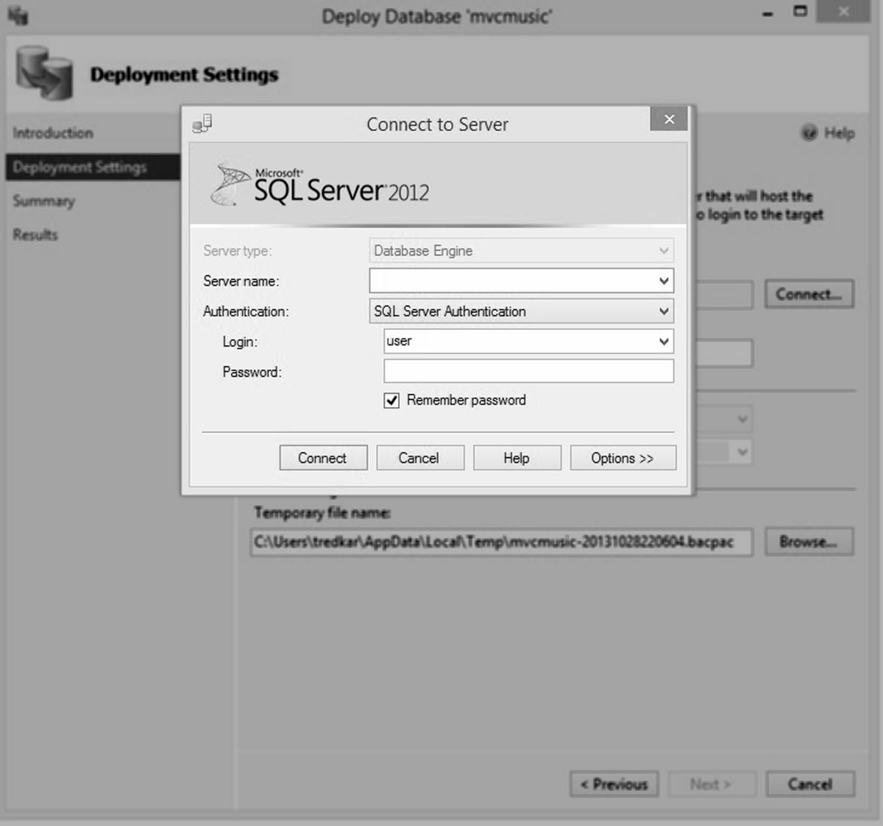
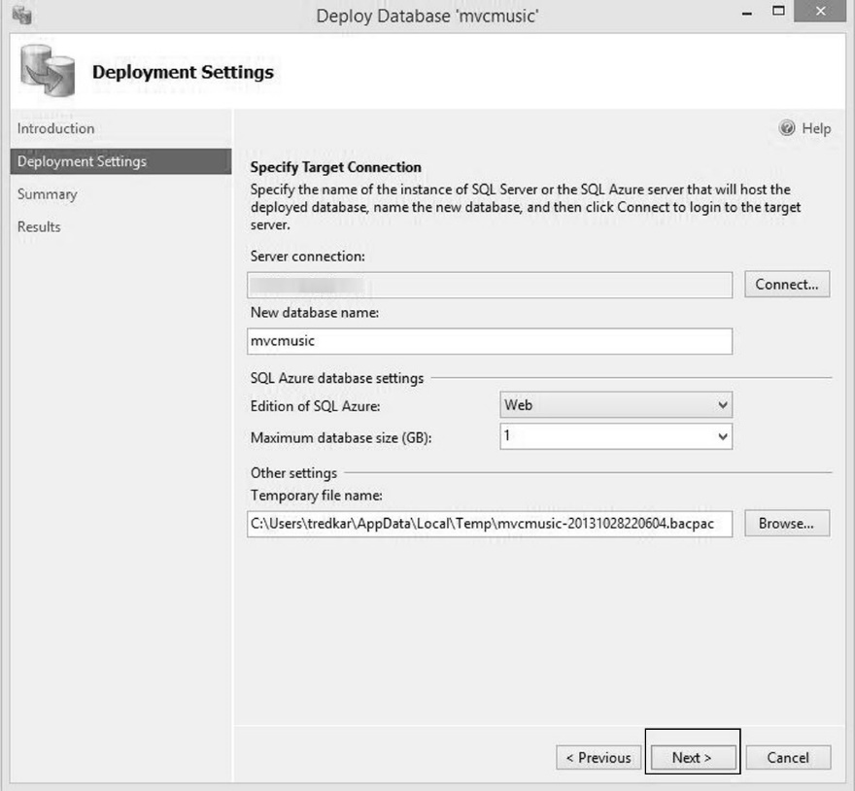
Migrating Application Database

Slide 194
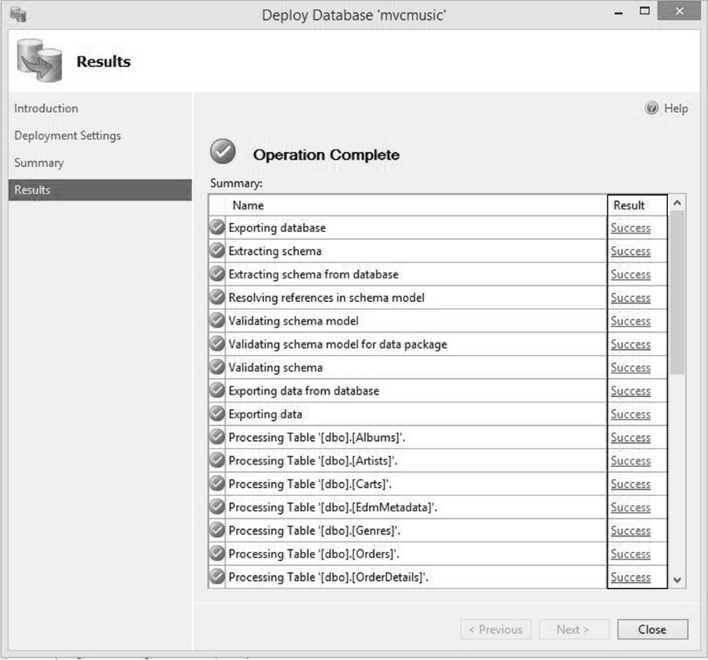
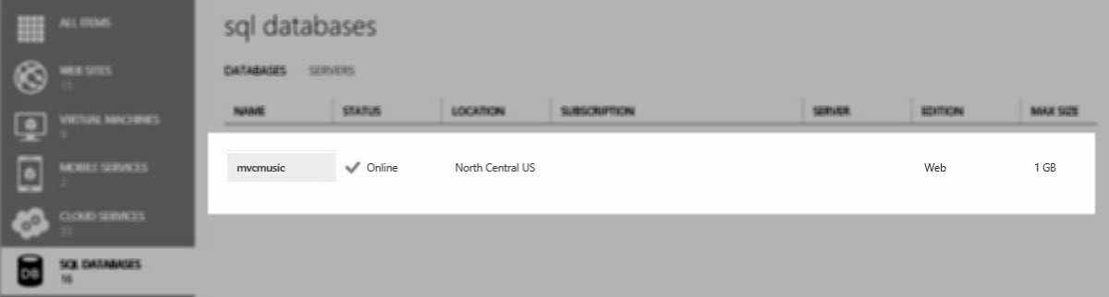
Migrating Application Database

Slide 195


Modify web.config

Slide 196
This was just one database ☺

Slide 197


Migrating Membership Database to Azure SQL
1) ASPNETDB.MDF
2) Microsoft ASP.NET Universal Providers

Slide 198

Migrating Membership Database to Azure SQL
Modify web.config

Slide 199

Migrating Membership Database to Azure SQL
Run the website to create
Membership and session tables

Slide 200




Publish the website to WAWS

Slide 201
Congratulations! We just moved the data-tier out of the website.

Slide 202
Migration Activities
Migrating Databases (the 800 pound Gorilla)
Application Database
Membership Database
Enable Session Management
Adding ElasticSearch support
Adding Custom Analytics with PIWIK

Slide 203

Basic Search Concept

Slide 204
ElasticSearch Concepts
http://www.elasticsearchtutorial.com/
http://www.elasticsearchtutorial.com/basic-elasticsearch-concepts.html
http://joelabrahamsson.com/elasticsearch-101/
http://www.elasticsearch.org

Slide 205

Music Store Search Conceptual Architecture
Notes:
ElasticSearch: C:\downloads\elasticsearch-0.90.7\elasticsearch-0.90.7\bin\elasticsearch.bat

Slide 206
Run ElasticSearch locally and with dynamicdeploy.com Live: http://elasticsearchvm.cloudapp.net:9200/ Head: http://elasticsearchvm.cloudapp.net:9200/_plugin/head/

Slide 207
Deploying ElasticSearch Virtual Machine using dynamicdeploy.com
Deploy page
http://www.dynamicdeploy.com/packagedetails.aspx?pkgid=89
Step-by-step procedure
http://t.co/wguojva0Mi
Notes:
ElasticSearch VM Admin Name: qwpxaklckoosvqt

Slide 208


2 Deployment Options
2-node cluster with membership
Free 1 VM

Slide 209
Step-by-step procedure for adding search to Music Store is addressed in Ch. 7 of my book.
http://t.co/wguojva0Mi

Slide 210
Album Ingestion
//Add the assembly reference to NEST
using Nest;
//...
//Define a ReIndex Action
public ActionResult ReIndex()
{
//Retrieve the elasticsearch Uri from
//configuration
string elasticSearchUri =
ConfigurationManager.AppSettings
["elasticsearchUri"];
//Create a connection settings object with the
//Uri
var setting =
new ConnectionSettings(new
Uri(elasticSearchUri));
//Create a new ElasticClient object with the
//connection settings
var client = new ElasticClient(setting);
//Retrieve theindex name from configuration
string elasticsearchindexname =
ConfigurationManager.AppSettings
["elasticsearchindexname"];
//For each album call the Index() function
foreach (var album in db.Albums)
{
client.Index(album, elasticsearchindexname, "albums", album.AlbumId);
}
//Redirect back to the Index() action
return RedirectToAction("Index");
}

Slide 211

Index

Slide 212
Browse
public ActionResult Browse(string genre)
{
var result =
ElasticClient.Search<Album>(body =>
body.Query(query =>
query.ConstantScore(
csq => csq.Filter(filter =>
filter.Term(x =>
x.Genre.Name, genre.ToLower()))))
.Take(1000));
var genreModel = new Genre()
{
Name = genre,
Albums = result.Documents.ToList()
};
return View(genreModel);
}

Slide 213
Music Store Search & Browse using ElasticSearch Head: http://elasticsearchvm.cloudapp.net:9200/_plugin/head/

Slide 214
Migration Activities
Migrating Databases (the 800 pound Gorilla)
Application Database
Membership Database
Enable Session Management
Adding ElasticSearch support
Adding Custom Analytics with PIWIK

Slide 215

Deploy Piwik VM
http://www.dynamicdeploy.com/packagedetails.aspx?pkgid=99
Notes:
Admin: ulqiqvafbalfvcu

Slide 216
Piwik Tracking Code Snippet
<!-- Piwik --> <script type="text/javascript"> var pkBaseURL = (("https:" == document.location.protocol) ? "https://piwikvm.cloudapp.net/piwik/" : "http://piwikvm.cloudapp.net/piwik/"); document.write(unescape("%3Cscript src='" + pkBaseURL + "piwik.js' type='text/javascript'%3E%3C/script%3E")); </script><script type="text/javascript"> try { var piwikTracker = Piwik.getTracker(pkBaseURL + "piwik.php", 1); piwikTracker.trackPageView(); piwikTracker.enableLinkTracking(); } catch( err ) {} </script><noscript><p><img src="http://piwikvm.cloudapp.net/piwik/piwik.php?idsite=1" style="border:0" alt="" /></p></noscript> <!-- End Piwik Tracking Code -->
Notes:
Admin: ulqiqvafbalfvcu

Slide 217
Custom Analytics http://piwikvm.cloudapp.net

Slide 218
Migration Activities
Migrating Databases (the 800 pound Gorilla)
Application Database
Membership Database
Enable Session Management
Adding ElasticSearch support
Adding Custom Analytics with PIWIK

Slide 219
Congratulations! We completely modernized the Music Store website.

Slide 220
Case Study: dynamicdeploy.com

Slide 221

A deployment service for Windows Azure apps & VMs http://www.dynamicdeploy.com/

Slide 222

Product Features

Slide 223

Architecture

Slide 224
Only Web Roles can be migrated

Slide 225
POP QUIZ: What will you do next?

Slide 226

Website Capability Model

Slide 227

Website Capability Model

Slide 228

Website Capability Model

Slide 229

Website Capability Model

Slide 230
Migration Activities
Migrating the Session Management to Windows Azure SQL Database or Windows Azure Shared Cache
Migrating Caching to In-Memory cache or Windows Azure Shared Cache

Slide 231

Session Management using Shared Cache
http://www.windowsazure.com/en-us/pricing/details/cache/

Slide 232

Create Cache Endpoint

Slide 233

Install Windows Azure Caching Nuget package

Slide 234

Modify web.config

Slide 235

Modify the dataCacheClient section

Slide 236
Using ASP.NET Session Object
//Add an object to session
string sessionKey = "packageId";
string sessionValue = "XXXXXXXXXXXX";
Session.Add(sessionKey, sessionValue);
//Retrieve object from Session
string sessionValue = Session[sessionKey] as string;

Slide 237

Caching using Shared Cache
Current In-Role Cache Configuration
Identifier is the name of the Web Role

Slide 238

Caching using Shared Cache
Cache Configuration for Shared Cache
Identifier is the name of the shared cache endpoint

Slide 239
Using Data Cache objects in code
// default Cache client initialized from configuration settings.
DataCacheFactoryConfiguration config =
new DataCacheFactoryConfiguration("default");
DataCacheFactory cacheFactory =
new DataCacheFactory(config);
DataCache defaultCache =
cacheFactory.GetDefaultCache();
// Store and retrieve an object from the default //cache.
defaultCache.Put("packageId", "XXXXXXXX");
string packageId =
(string) defaultCache.Get("packageId");
// Initialize cache client directly (without //factory)
DataCache ddCache = new DataCache("ddcache");
// Put and retrieve a test object from the default cache.
ddCache.Put("packageConfig", "YYYYYYYYYYYY");
string packageConfig =
(string) ddCache.Get("packageConfig");

Slide 240

Estimated Operating Cost Comparison

Slide 241
Summary
Website Capability Model
Migrating Music Store to WAWS
Migrating databases
Adding ElasticSearch support
Adding custom analytics with Piwik
Migrating dynamicdeploy.com to WAWS
Migrating session management to shared cache
Migrating cache management to shared cache

Slide 242
07 | Lightning Round
James Chambers | Author, Microsoft ASP.NET/IIS MVP
Tejaswi Redkar | Author, Director of Business Programs (AppPlat)

Slide 243
Module Overview
Hybrid Connectivity
Scaling SignalR Using Service Bus
Office 365 Domain credentials integration
Node.js + Mongo DB
Storage Object Distribution Pattern
Push Notifications: Windows 8, Web API and WNS

Slide 244
Hybrid Connectivity

Slide 245
Hybrid Connectivity
Connecting your cloud applications with applications residing in your own datacenter, typically behind a firewall
WAWS does not support network-level connectivity with Virtual Network
WAWS does support application-level connectivity using Service Bus

Slide 246
Common Scenarios
You want your website to retrieve customer data from a Line of Business (LOB) system such as a purchase order or a Customer Relationship Management (CRM) application residing in your datacenter behind a firewall (e.g. Healthcare or Insurance user registration portal that sends data to CRM in your datacenter)
You want to retrieve data from a data repository such as a database or a search engine that cannot be migrated to the cloud due to compliance and regulatory reasons

Slide 247

Solution Architecture

Slide 248
Windows Azure IP Address Ranges
http://msdn.microsoft.com/en-us/library/windowsazure/dn175718.aspx

Slide 249
Rendezvous (TCP & HTTP)
Service Bus
NetTcpRelayBinding
WebHttpRelayBinding
BasicHttpRelayBinding
WS2007RelayBinding
Rendezvous Handshake
Bi-Directional
Net.Tcp Full Duplex
No message size limit
sb://solution.servicebus.windows.net/a/b/
Backend Naming
Routing Fabric
Frontend Nodes
Ctrl
NLB
2
3
TCP/SSL or HTTP
Ctrl
outbound socket connect
outbound socket rendezvous
1
Sender
4
Receiver

Slide 250
Implementation Resources
.NET On-Premises/Cloud Hybrid Application Using Service Bus Relay
This reference article from Microsoft is a step-by-step procedure in building a simple hybrid connectivity between applications.
http://www.windowsazure.com/en-us/develop/net/tutorials/hybrid-solution/
How to Use the Service Bus Relay Service
This is another basic tutorial on getting started with Service Bus
http://www.windowsazure.com/en-us/develop/net/how-to-guides/service-bus-relay/
How to integrate a Windows Azure Web Site with a LOB app via a Service Bus Relay Service
This is an advanced article on integrating WAWS with an LOB app using Service Bus Relay and the author also adds Windows Azure Notification Hubs for sending back notifications to mobile devices when the product catalog changes. I recommend reading this article after finishing 1) & 2)
http://blogs.msdn.com/b/paolos/archive/2013/10/24/how-to-integrate-a-windows-azure-web-site-with-a-lob-app-via-a-service-bus-relay-service.aspx
Notes:
http://msdn.microsoft.com/en-us/library/windowsazure/dn175718.aspx

Slide 251
Tools
Service Bus Explorer
This is client tool for monitoring and managing Service Bus namespaces. You can download the code from the following location.
http://code.msdn.microsoft.com/windowsazure/Service-Bus-Explorer-f2abca5a
Port Bridge
Port Bridge is a proxy server that abstracts TCP connection bindings between the client and the server in a Service Bus interaction. Means, with Port Bridge, you no longer have to build WCF interfaces for the service, but instead add a Port Bridge indirection layer between the client and the service. Port Bridge will then forward web service calls to the appropriate on-premises LOB application or service. Port Bridge was originally built by Clemens Vasters and it is not updated or supported by Microsoft. You can learn more information about Port Bridge at the following locations.
Port Bridge Concepts
http://blogs.msdn.com/b/clemensv/archive/2009/11/18/port-bridge.aspx
Integrating On-Premises Web Services with Windows Azure Service Bus and Port Bridge
http://msdn.microsoft.com/en-us/library/windowsazure/hh697517.aspx

Slide 252
Hybrid Music Store Search using PortBridge
http://mvcmusichybrid.azurewebsites.net
Music Store
FIREWALL
ElasticSearch
PortBridge Service
Service Bus Relay
PortBridge Agent
(VM)
http://piwikvm.cloudapp.net:9200
My local machine (private datacenter)

Slide 253
PortBridge Setup
Create ServiceBus Namespace named portbridge
Run ElasticSearch on local machine (private datacenter)
Configure PortBridge Service on local machine
Run PortBridge Service on local machine
Configure PortBridge Agent on a VM
Run PortBridge Agent on a VM
Open VM endpoints for ElasticSearch (9200,9300)
Test basic connectivity http://piwikvm.cloudapp.net:9200
Deploy Mvc Music Hybrid as another website (http://mvcmusichybrid.azurewebsites.net )
Configure Music Store to point to the new search endpoint (using Web Sites Configuration in portal) http://mvcmusichybrid.azurewebsites.net
Reindex Music Albums http://mvcmusichybrid.azurewebsites.net/StoreManager/ReIndex
Test index data (http://piwikvm.cloudapp.net:9200/_plugin/head/ )
Test Browse and Search functionality

Slide 254

Source: http://wallpaperuser.com/wp-content/uploads/2012/01/demon-cat-wallpaper.jpg

Slide 255
Hybrid Music Store

Slide 256
Scaling SignalR with Service Bus

Slide 257
SignalR – Makes Real Time Web “Easy”
At its root, it’s just pub-sub
C# on the server in “hubs”
Serializes messages as JSON
Uses the best transport available and scales back as negotiated
Client can be anything that can deserialize JSON
Lots of pre-existing clients
Notes:
Clients: jQuery, Windows 8, iOS, Windows Phone, Android, .Net

Slide 258
SignalR with Service Bus

Slide 259
Office 365 Domain Authentication

Slide 260



Identity with Office 365
Authenticating users who are members of your O365 domain
Visual Studio authenticates against O365 domain
O365 domain configuration added to Web.config of web site project
Web site published to Windows Azure
Users authenticate using their O365 credentials and are validated against the domain

Slide 261



Multi-tenant Identity with WAAD
Federate with O365 or On-Premise Active Directory

Slide 262

Registering for Office 365 Domain
You can open an Office 365 account or a preview account by navigating here http://www.microsoft.com/office/cxm/en-us/home-premium/
https://portal.microsoftonline.com/
Notes:
https://portal.microsoftonline.com/

Slide 263



Configuring ASP.NET Website for Federation
Notes:
https://portal.microsoftonline.com/

Slide 264
Important Steps
Migrate the default SQL Server database from the website’s App_Data folder to Azure SQL. Without this migration, your website will not work.
Modify the replyUrl , and any other reference to localhost from the <system.identityModel.services> section in web.config to point to the URL of the WAWS you created.

Slide 265
Important Steps
<federationConfiguration>
<cookieHandler requireSsl="true" />
<wsFederation
passiveRedirectEnabled="true"
issuer="https://login.windows.net/dynamicdeployllc.onmicrosoft.com/wsfed"
realm="https://dynamicdeployllc.onmicrosoft.com/o365singlesignon"
requireHttps="true" reply="[Your Reply URL]" />
</federationConfiguration>

Slide 266


Publish
Notes:
https://portal.microsoftonline.com/

Slide 267
Office 365 Domain Authentication

Slide 268
Node.js + Mongo DB

Slide 269
The Cool Kids are Doing It
Strong, growing community around Node.js
Applications are easy to start and piece together
Templates available in Windows Azure Web Sites
“It just works”
Notes:
Because WAWS is just running node.exe, everything works as you’d expect

Slide 270
Node.js + Mongo DB

Slide 271
Storage Object Distribution Pattern

Slide 272
Compute services are expensive even if you cache objects in memory

Slide 273
The Storage Object Distribution pattern allows you to leverage the scale and bandwidth of storage services, yet access application objects like if you were calling a REST API to retrieve the object.

Slide 274
Key Features
Distribute JSON Objects to Windows Azure Blob storage
HTTP-Cache enable these objects
Clients accesses JSON objects from storage directly
Compute services (e.g. WAWS) can focus on transaction intensive requests

Slide 275
Common Scenario
Your website has static/semi-static objects that require low-latency mobile access (e.g. customer profile, gaming apps, etc.)

Slide 276

Traditional Architecture

Slide 277

Architecture with Storage Object Distribution Pattern
Notes:
Example: https://dynamicdeploypkgs2.blob.core.windows.net/appsforazureobjectstest/servicepackages.json

Slide 278
Blob Extension Methods
//Extension to the Blob Class
public static class BlobExtensions
{
//A convenience method to set the Cache-Control //header.
public static void SetCacheControl
(this ICloudBlob blob, string value)
{
blob.Properties.CacheControl = value;
blob.SetProperties();
}
public static void SetContentType
(this ICloudBlob blob, string value)
{
blob.Properties.ContentType = value;
blob.SetProperties();
}
//Set both the properties from a single method
public static void
SetCacheControlContentType
(this ICloudBlob blob, string cacheControl, string contentType)
{
blob.Properties.ContentType =
contentType;
blob.Properties.CacheControl =
cacheControl;
blob.SetProperties();
}
}
Notes:
Example: https://dynamicdeploypkgs2.blob.core.windows.net/appsforazureobjectstest/servicepackages.json

Slide 279
Distribute Objects Code Snippet
public static string DistributeObject(
string containerName,
string blobName,
string restUrl,
string cacheControl = "public, max-age=3600, must-revalidate",
string contentType="application/json")
{
using (WebClient w = new WebClient())
{
if (StorageHelperNew.DoesBlobExist(containerName, blobName))
{
ICloudBlob blob = StorageHelperNew.GetBlob(containerName, blobName, fetchAttributes:true);
/*
if the different between now and blob's last modified is greater than 45 mins, then only modify
*/
if ((DateTime.UtcNow – blob.Properties.LastModified) < TimeSpan.FromMinutes(45))
{
return "";
}
}
//Download the JSON blob from Web Api and upload //it to Blob Storage
string ret = StorageHelperNew.PutBlob(containerName, blobName, w.DownloadData(restUrl), true);
//Set the Cache Control and the Content Type of the blob
StorageHelperNew.SetCacheControlContentType(containerName,blobName,cacheControl, contentType);
//return the Blob Uri
return ret;
}
return "";
}
Notes:
Example: https://dynamicdeploypkgs2.blob.core.windows.net/appsforazureobjectstest/servicepackages.json

Slide 280
“The products are taking longer to load in the Windows 8 Store app”
Dynamic Deploy Windows Store App Developer

Slide 281
SOD for dynamicdeploy.com products
12:38
Windows 8 App
Web Services
Mobile Devices
HTTP Cache Enabled
Products/All/Search/Individual Items
JSON
Windows Azure Blob Storage
Object Distributor
Object Distributor
Custom Objects
Databases
(SQLAzure)

Slide 282
Test URL
https://dynamicdeploypkgs2.blob.core.windows.net/appsforazureobjectstest/servicepackages-categoryall.json

Slide 283


Fiddler Trace
First request, before cache
Subsequent requests
Egress Cost = $0
Notes:
Example: https://dynamicdeploypkgs2.blob.core.windows.net/appsforazureobjectstest/servicepackages.json

Slide 284
Push Notifications: Windows 8, Web API and WNS

Slide 285
The Technical Brew
Windows 8 apps have a similar look-and-feel and shared behaviors with the intention of making users feel more comfortable
Web API (part of Asp.Net) allows easy creation of HTTP services
WNS – Windows Push Notification Service – gives you the ab

Slide 286
Push Notifications

Slide 287
Summary
Hybrid Connectivity
Cloud Survey
Office 365 Domain credentials integration
Node.js + Mongo DB
Storage Object Distribution Pattern
Push Notifications – Windows 8 Apps + Web API + WNS

Slide 288

Thank You

